Slide 1
Module E: Distributed Scientific Computing
Lecture E-1 and E-2: Introduction to the Theory and Practice of Distributed Computing
Dr Shantenu Jha
http://radical.rutgers.edu

Slide 2
Module Dynamics
Shantenu Jha [first-name at lsu dot edu]
Email/skype
Other matter: Coordinate with Dr Frank Loeffler
Grading:
2 Assignments [5% x 2]
1 Project [10%]

Slide 3
Overview of Module E Distributed Scientific Computing
E1: Introduction to Distributed Scientific Computing
Examples of Distributed Applications
WLCG + Application Examples
Summarize and compare with HPC
Examples of “Production” Grid Infrastructure
HPC vs HTC, Research vs Production, Commercial
Distributed Computing is Hard. Why?
E2: Introduction to the Practice of DSC
Introduction to SAGA
Introduction to Pilot-Jobs (BigJob)
Mod E Project

Slide 4
Overview of Module E Distributed Scientific Computing
E3: Introduction to Cloud Computing
Introduction to Commercial / Enterprise DC aka Cloud Computing (EC2, Azure, Google) [30mins]
Using FutureGrid [30mins]
Using the Master-Worker Pattern [15mins]
E4: To Distribute or not to Distribute?
Distributed Applications Redux [20mins]
Principles of Distributed Computing [20mins]
Project Discussion/Presentation [40mins]

Slide 5
E1: References
Distributed Computing Practice for Large-Scale Science & Engineering Applications:
https://www.github.com/saga-project/radical.wp/raw/master/publications/pdf/dpa-surveypaper_draft.pdf
D. S. Katz, S. Jha, M. Parashar, O. Rana, and J. Weissman. Survey and Analysis of Production Distributed Computing Infrastructures. Technical Report CI-TR-7-0811. Computation Institute, University of Chicago & Argonne National Laboratory:
http://www.ci.uchicago.edu/research/papers/CI-TR-7-0811

Slide 6
Distributed Applications
We will analyze a few “representative” DA
Montage: Image Mosaicking
Distributed-MPI / Meta-computing Simulations
Ensemble-based, Replica-Exchange Simulations
ClimatePrediction.net
SCOOP [Roughly put: Hurricane Modelling]
For each application we will understand four features:
A Brief Overview of the Application
Why it is (was) distributed?
How is the Application Distributed?
What are the challenges (or successes) ?

Slide 7
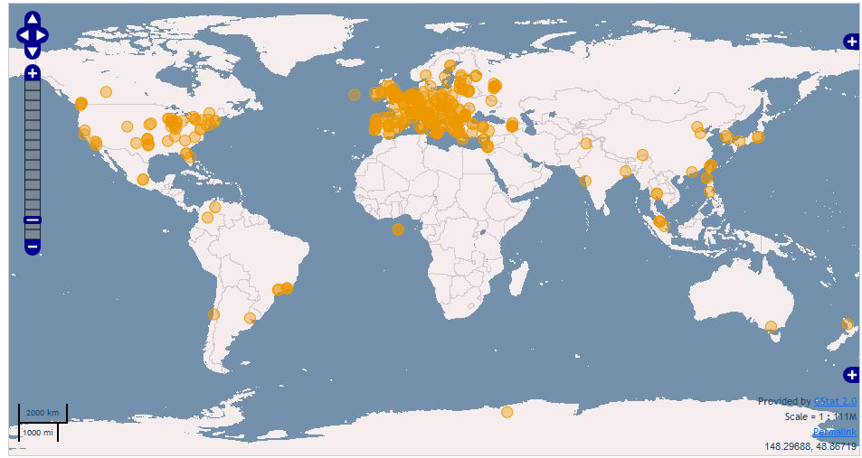
WLCG: Worldwide LHC Computing Grid A Driver of Grid Comuting Worldwide resources for WLCG
Today >140 sites
~250k CPU cores
~100 PB disk

Slide 8
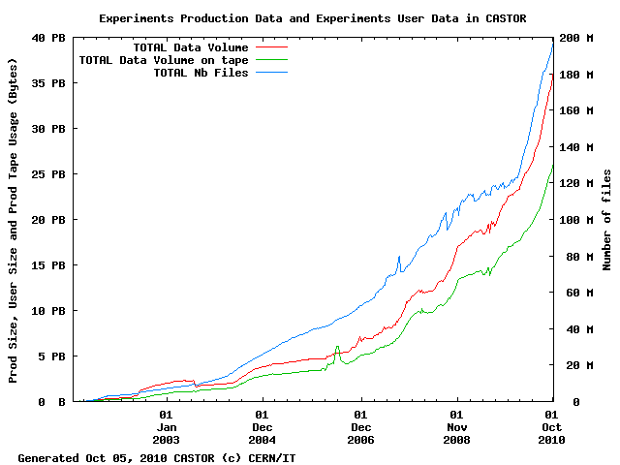
6 months of LHC data
Stored ~ 5 PB this year
Tier 0 storage:
Accepts data at average of 2.6 GB/s; peaks > 7 GB/s
Serves data at average of 7 GB/s; peaks > 18 GB/s
CERN Tier 0 moves ~ 1 PB data per day

Slide 9
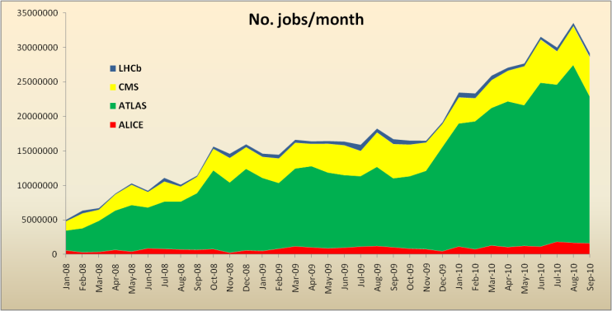
WLCG Usage
Use remains consistently high
1 M jobs/day; >>100k CPU-days/day
Actually much more inside pilot jobs
~50% utilisation
1 M jobs/day

Slide 10
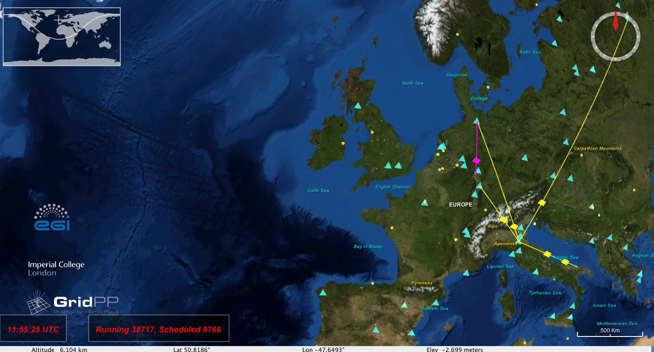
For realtime info: http://rtm.hep.ph.ic.ac.uk/webstart.php

Slide 11
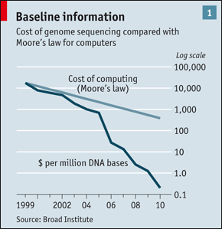
An Interesting Observation….
HW Assignment: Think about the implications of this graph.

Slide 12
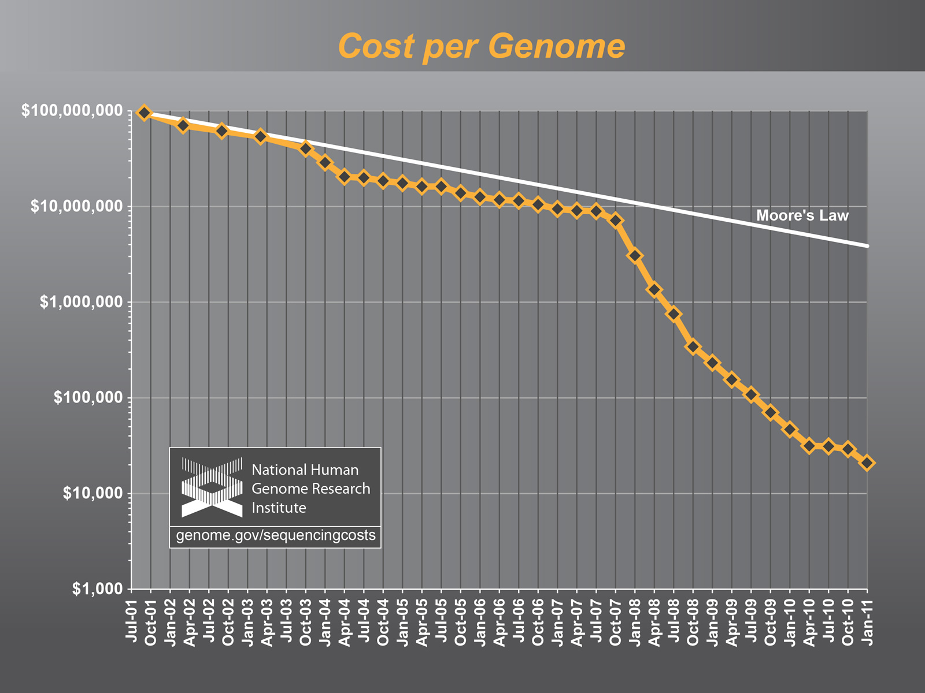
“There is a growing gap between the generation of massively parallel sequencing output and the ability to process and analyze the resulting data. New users are left to navigate a bewildering maze of base calling, alignment, assembly and analysis tools with often incomplete documentation and no idea how to compare and validate their outputs. Bridging this gap is essential, or the coveted $1,000 genome will come with a $20,000 analysis price tag."

Slide 13
MOntage

Slide 14
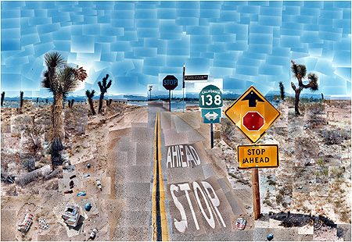
What is Montage?
Delivers custom, science grade image mosaics
An image mosaic is a combination of many images containing individual pixel data so that they appear to be a single image from a single telescope or spacecraft
User specifies projection, coordinates, spatial sampling, mosaic size, image rotation
Preserve astrometry (to 0.1 pixels) & flux (to 0.1%)
Modular, portable “toolbox” design
Loosely-coupled engines for image reprojection, background rectification, co-addition
Control testing and maintenance costs
Flexibility; e.g custom background algorithm; use as a reprojection and co-registration engine
Each engine is an executable compiled from ANSI C
Public service deployed
Order mosaics through web portal
David Hockney Pearblossom Highway 1986

Slide 15
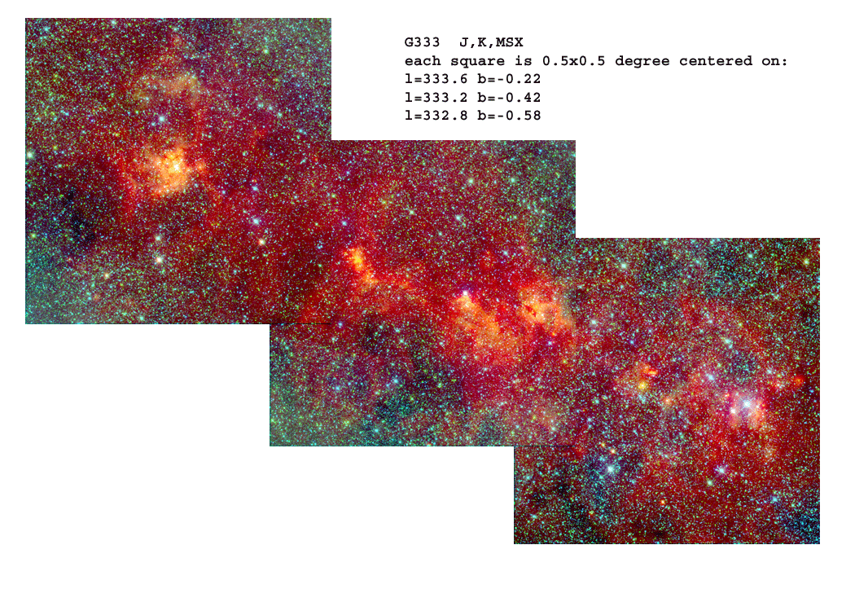
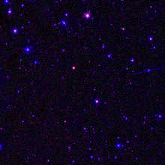

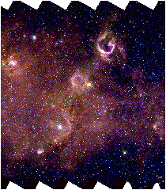
Montage use by Spitzer Legacy Teams
Color composite of co-registered 2MASS and MSX. Each square is 0.5 x 0.5 degrees
SWIRE
GLIMPSE
Data Federation for QA/validation Building Data Products
Mission Planning
Right: Spitzer IRAC 3 channel mosaic (3.6μm in green, 4.5μm in red, and i-band optical in blue); high redshift non-stellar objects are visible in the full resolution view (yellow box).
3-color GLIMPSE image mosaic over 1.1° x .8°

Slide 16

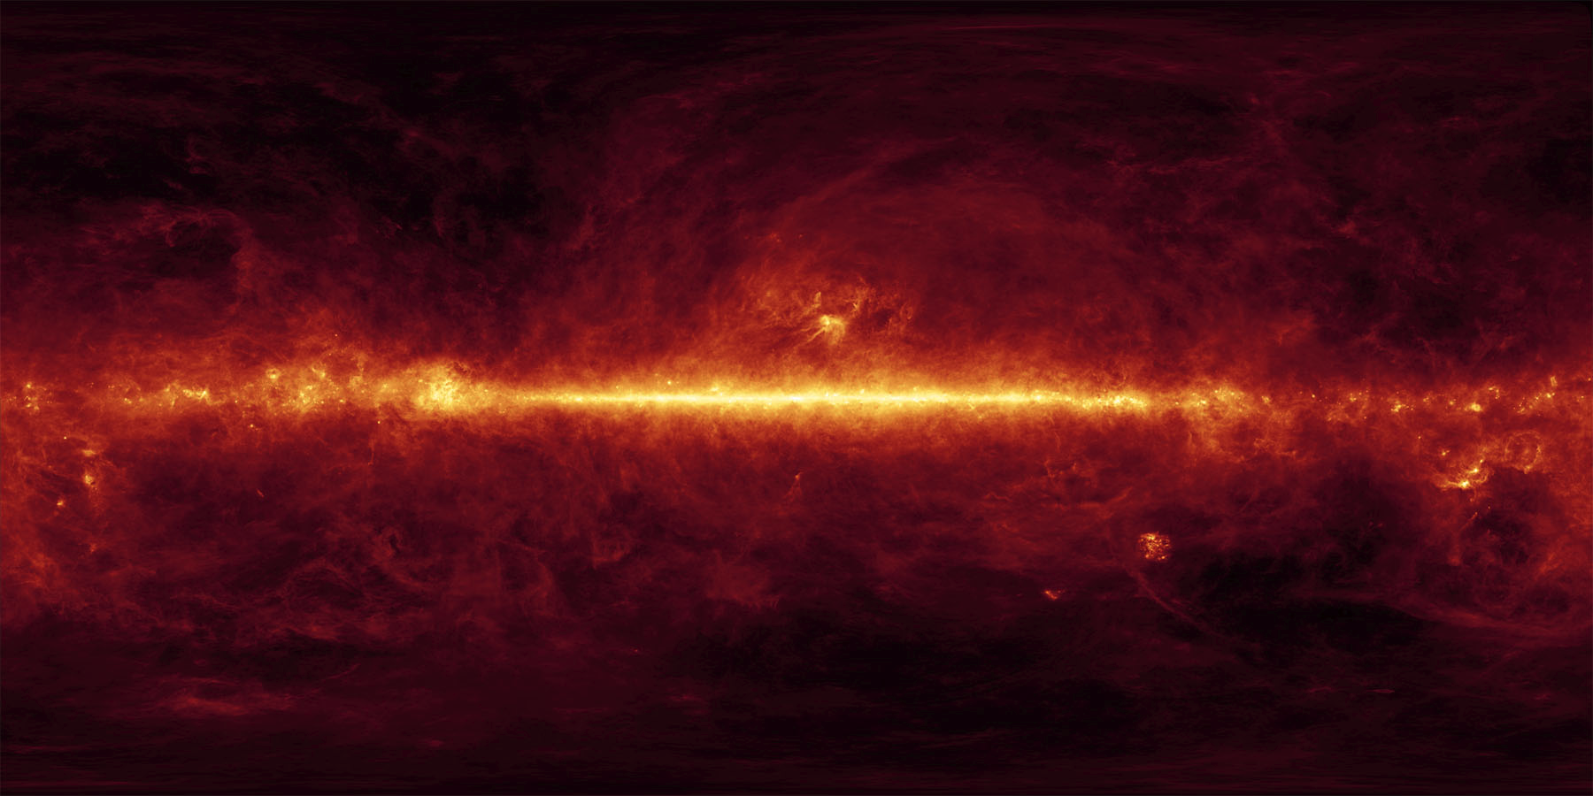
Montage Use by Spitzer E/PO Group
100 µm sky; aggregation of COBE and IRAS maps (Schlegel, Finkbeiner and Davis, 1998) 360° x 180°, CAR projection
Panoramic view of galactic plane as seen by 2MASS, 44° x 8°, 158,400 x 28,800 pixels; covers 0.8% of sky

Slide 17
Montage Workflow
2
3
Final Mosaic (Overlapping Tiles)
1
mProject 1
mProject 2
mProject 3
mAdd 1
mAdd 2
2
3
1
2
1
3
mDiff 1 2
mDiff 2 3
mBackground 1
mBackground 2
mBackground 3
D₁₂
D₂₃
a₁x + b₁y + c₁ = 0
a₂x + b₂y + c₂ = 0
a₃x + b₃y + c₃ = 0
mFitplane D₁₂
mFitplane D₂₃
mBgModel
ax + by + c = 0
dx + ey + f = 0
ax + by + c = 0
dx + ey + f = 0
mConcatFit

Slide 18
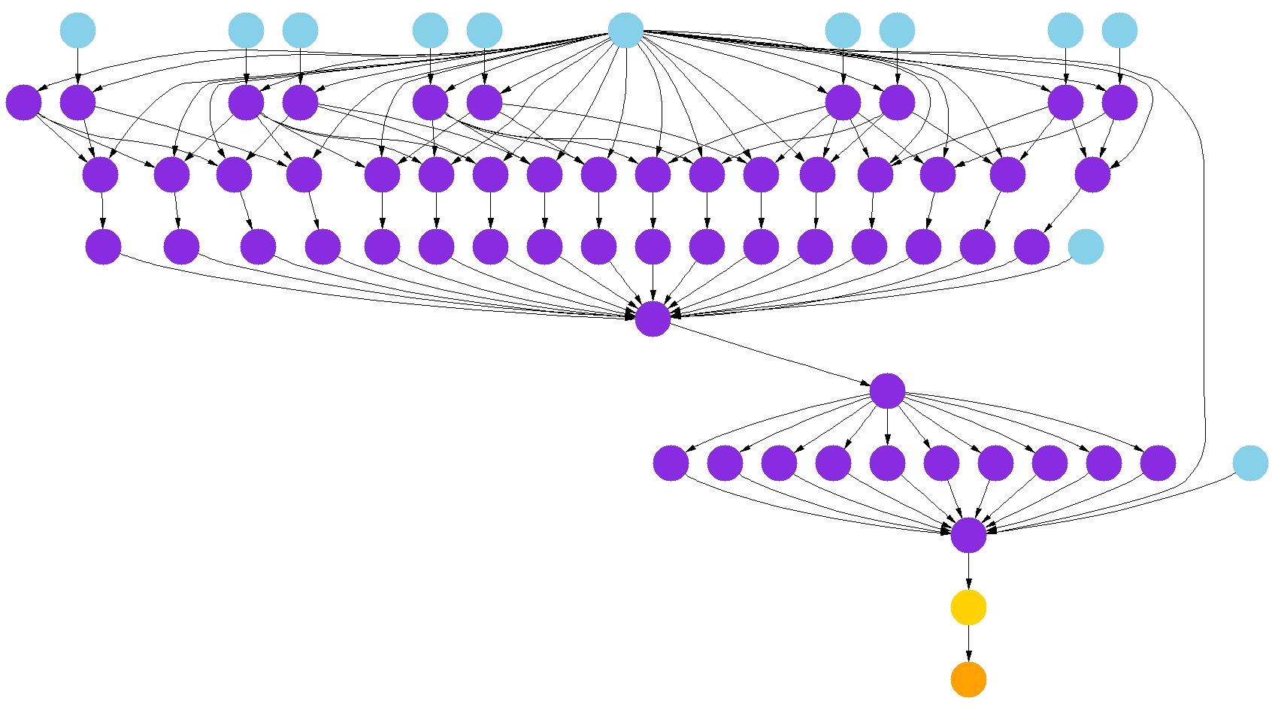
Montage on the Grid Using Pegasus
Example DAG for 10 input files
Maps an abstract workflow to an executable form
mProject
Pegasus
mDiff
http://pegasus.isi.edu/
mFitPlane
mConcatFit
mBgModel
Grid Information
Systems
mBackground
Information about available resources, data location
mAdd
Condor DAGMan
Data Stage-in nodes
Executes the workflow
Montage compute nodes
Data stage-out nodes
MyProxy
Grid
Registration nodes
User’s grid credentials

Slide 19
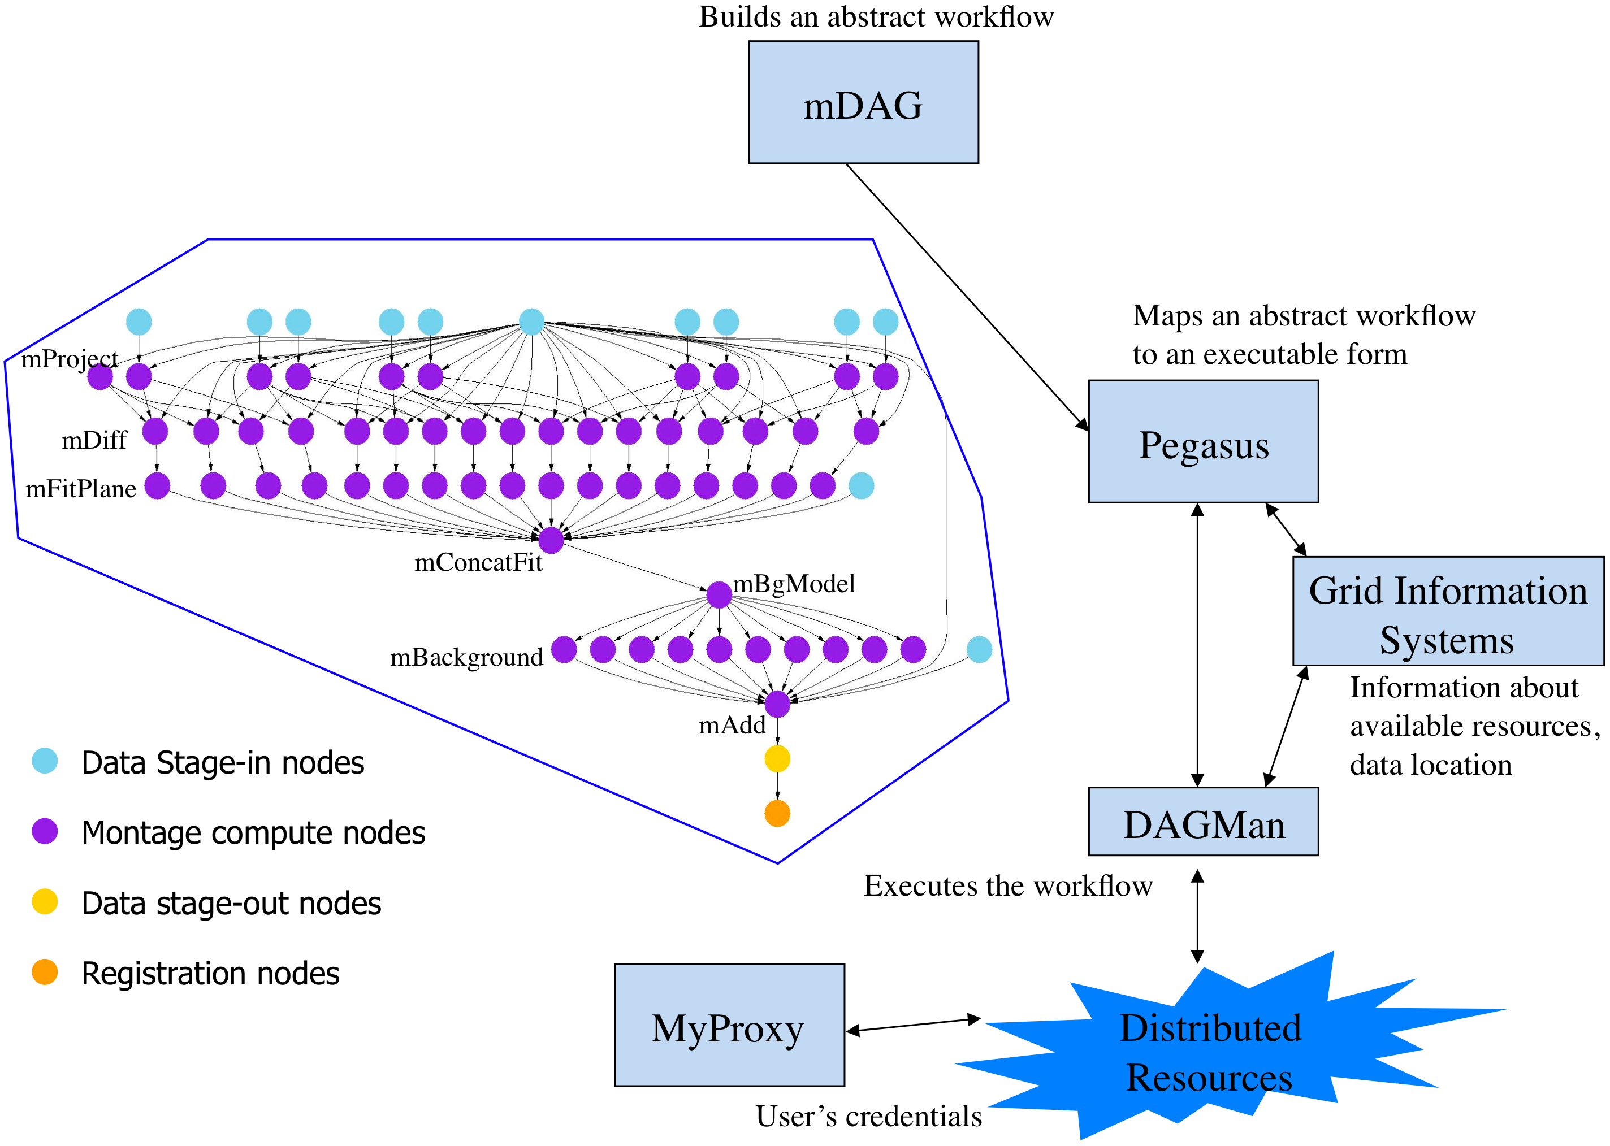
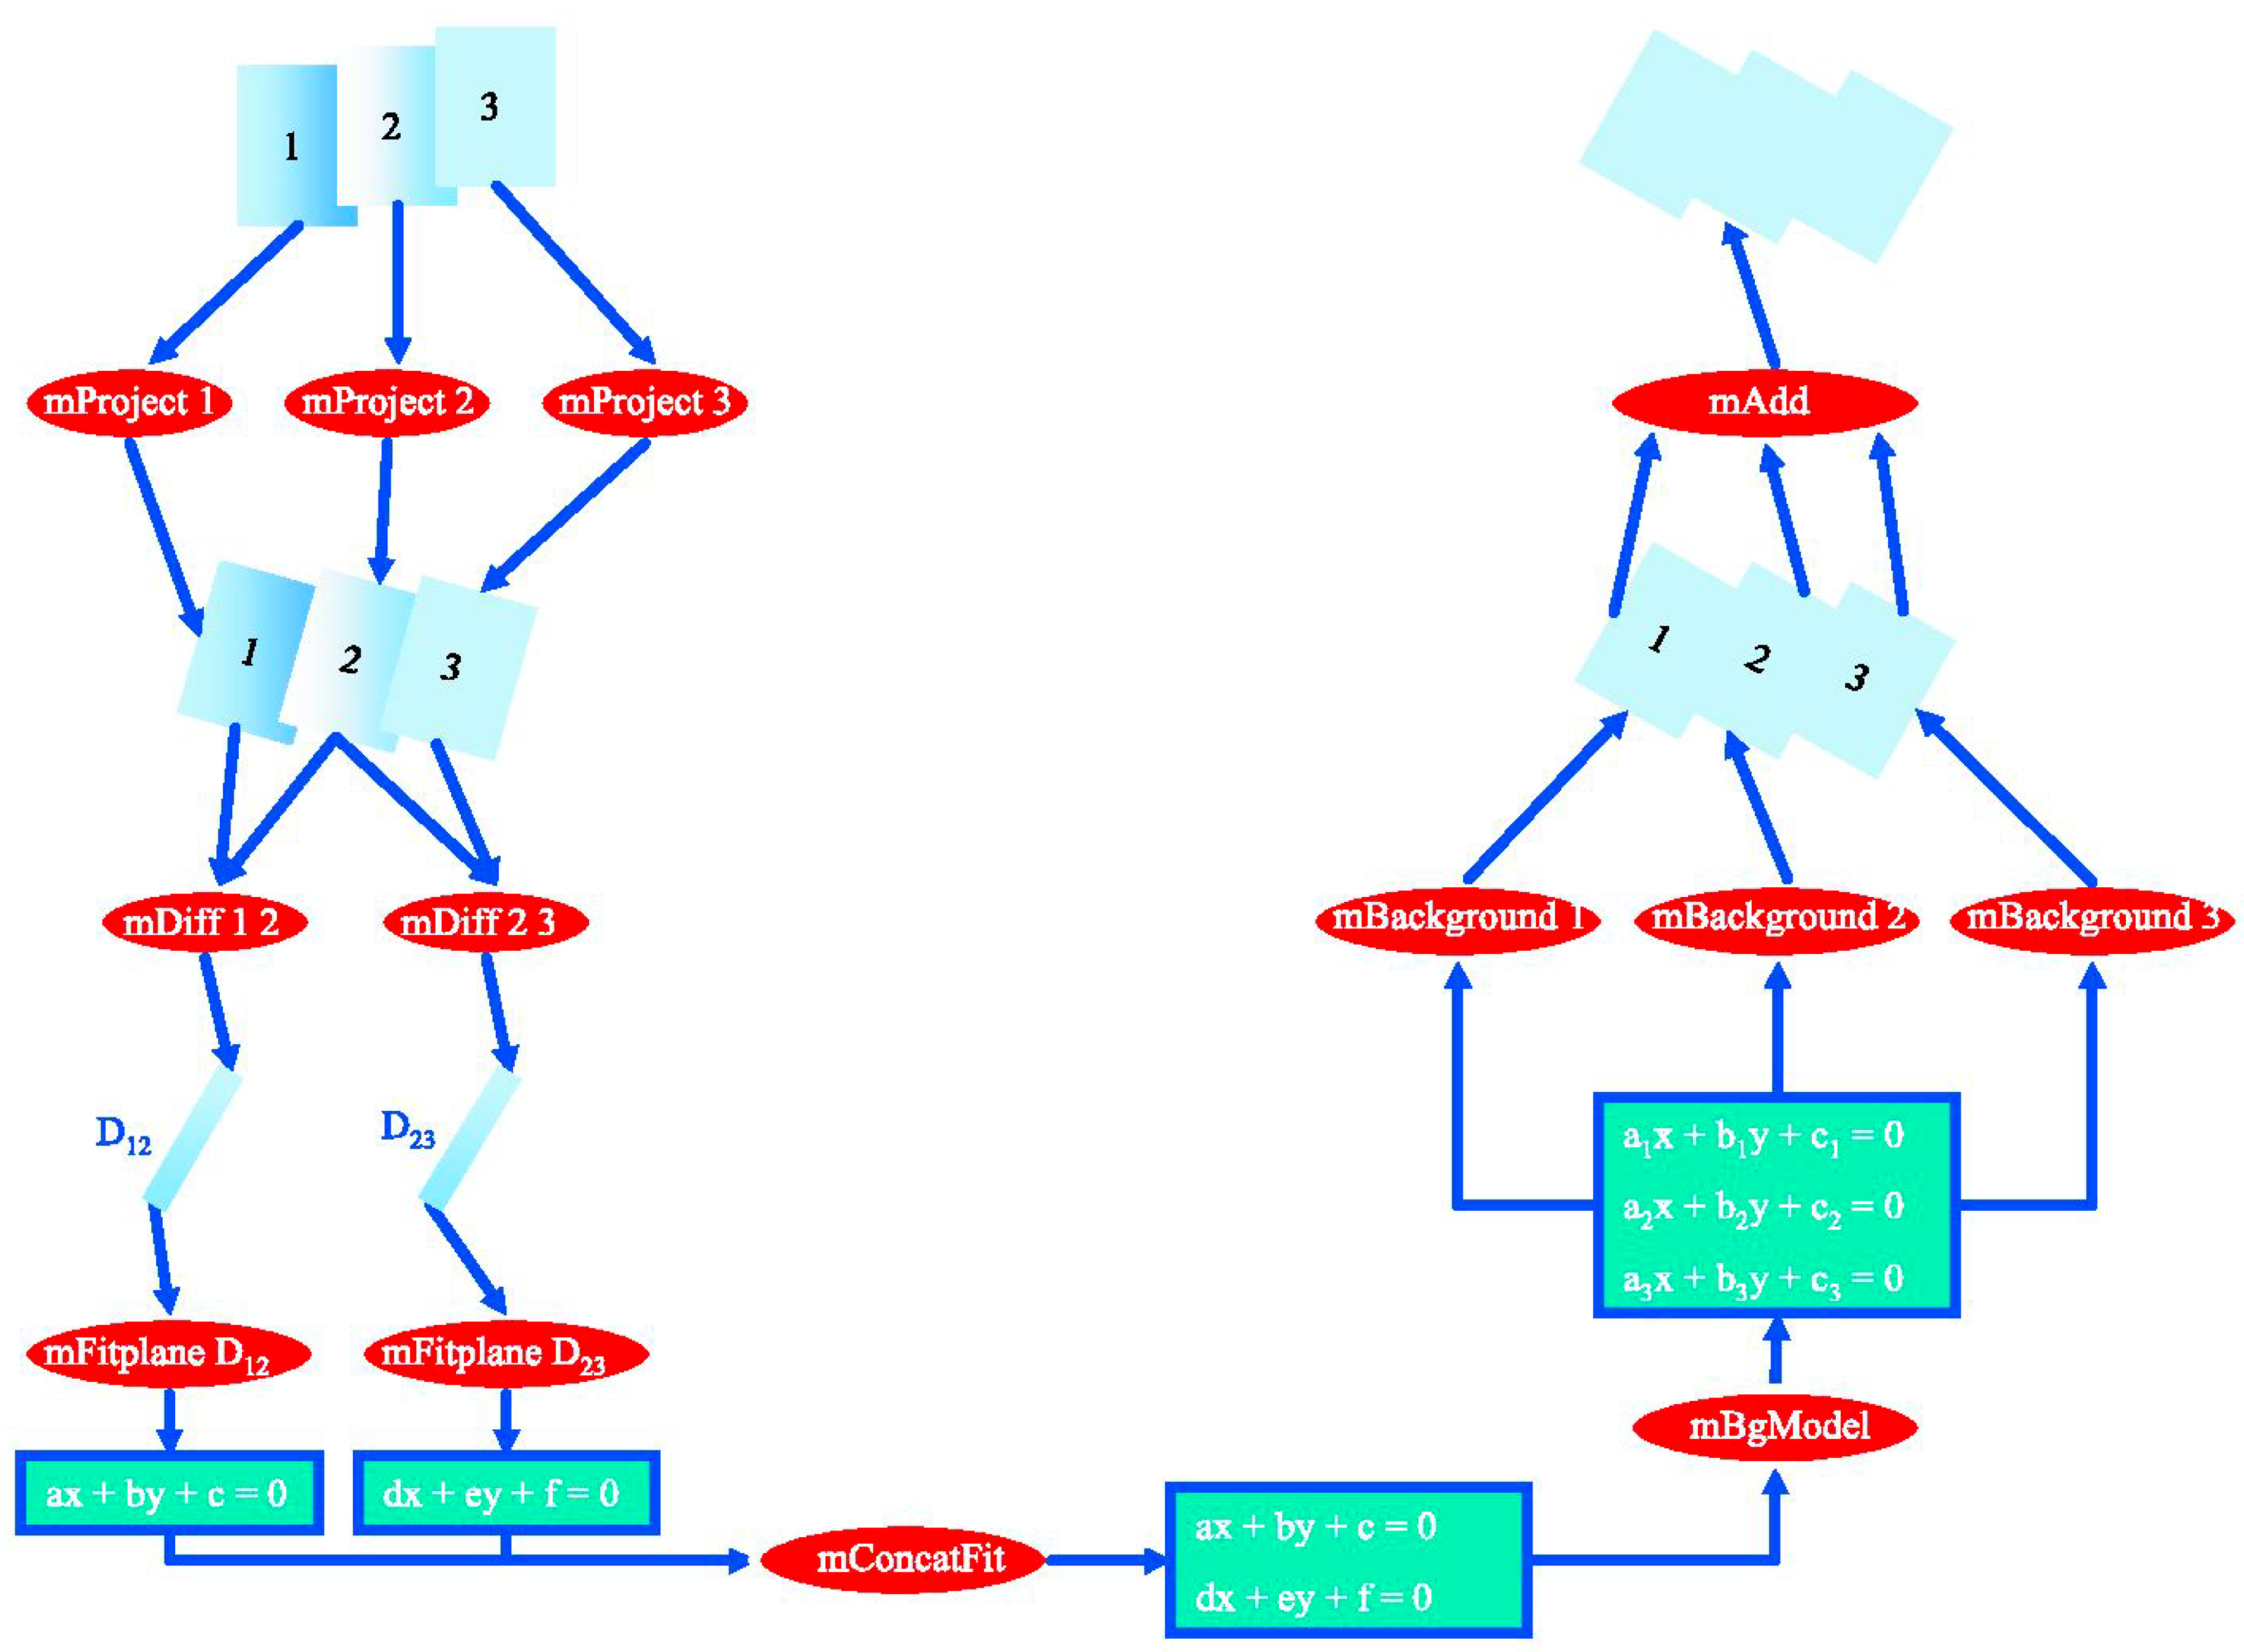
Montage: DAG-based Workflow Application Exemplar

Slide 20
Understanding Montage
Why distributed?
Scale Processing (over come size limits) above local limits
How distributed?
DAG is created
DAG is executed via a DAG-Enactor [DAGMAN]
Other approaches exist
Challenges/Issues/Success?
Mapping to right resources – to effectively use different resources, network (as now data transfer can become bottleneck)

Slide 21
NeKTAR

Slide 22
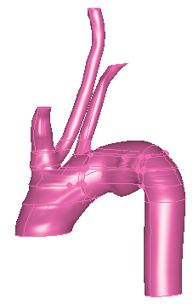
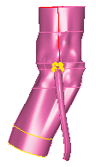
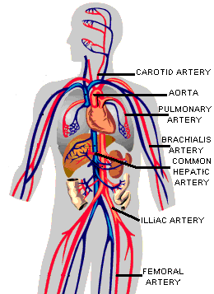
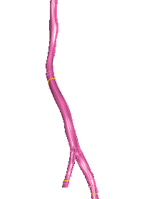
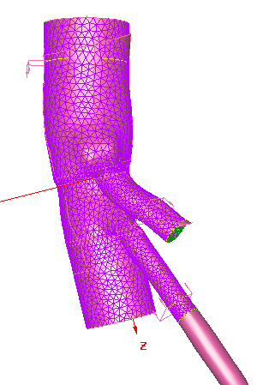
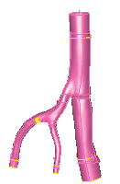
Simulation of Blood Flow in Human Arterial Tree
B Boghosian, P Coveney, S Jha et al, Cluster Computing, Vol. 10, No. 3, 351-364 (2007,) DOI 10.1007/s10586-007-0029-4 Courtesy George Karniadakis (Brown)

Slide 23
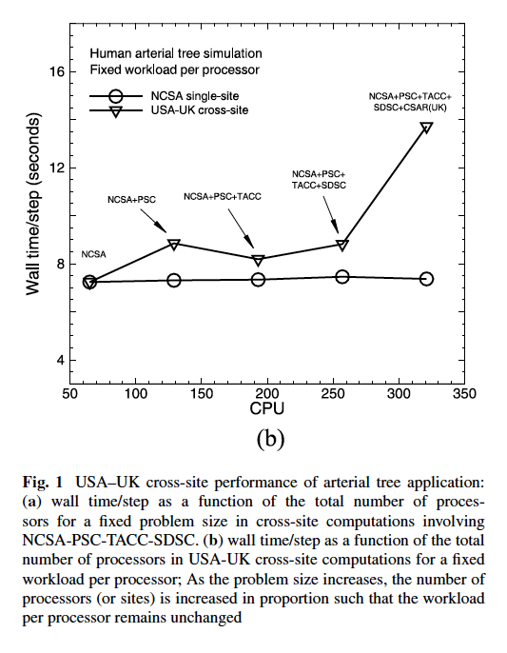
Cluster Computing, Vol. 10, No. 3, 351-364 (2007,) DOI 10.1007/s10586-007-0029-4

Slide 24
Understanding NeKTAR
Why distributed?
Full model Required 7 TB of RAM!! Factor of 10 greater
Scaled down resolution and tried to get as much as possible
Fundamental limitation on scalability of full 3D problem
Reformulated
How distributed?
MPI Based Application, use “distributed” library version of MPI
Resources selected in advance
Challenges/Issues/Success?
Co-scheduling
Single point of failure
Exponentially increasing with # of systems/resources used!

Slide 25
ENSEMBLE-BASED REPLICA-EXCHANGE

Slide 26
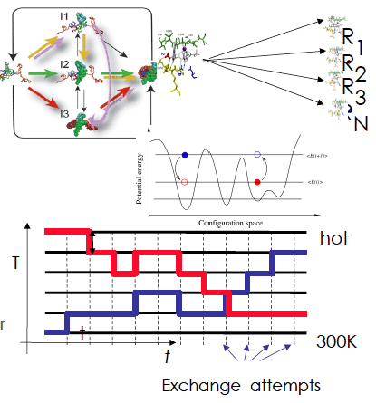
Ensemble-based & Replica-Exchange Simulations
Ensemble-based:
Many uncoupled simulations
But not necessarily uncoupled in analysis!
Replica-Exchange (RE) methods:
Represent a class of algorithms that involve a large number of loosely coupled ensembles.
RE simulations are used to understand a range of physical phenomena
Protein folding, unfolding etc
MC simulations
Many successful implementations
Eg folding@home [replica based]

Slide 27
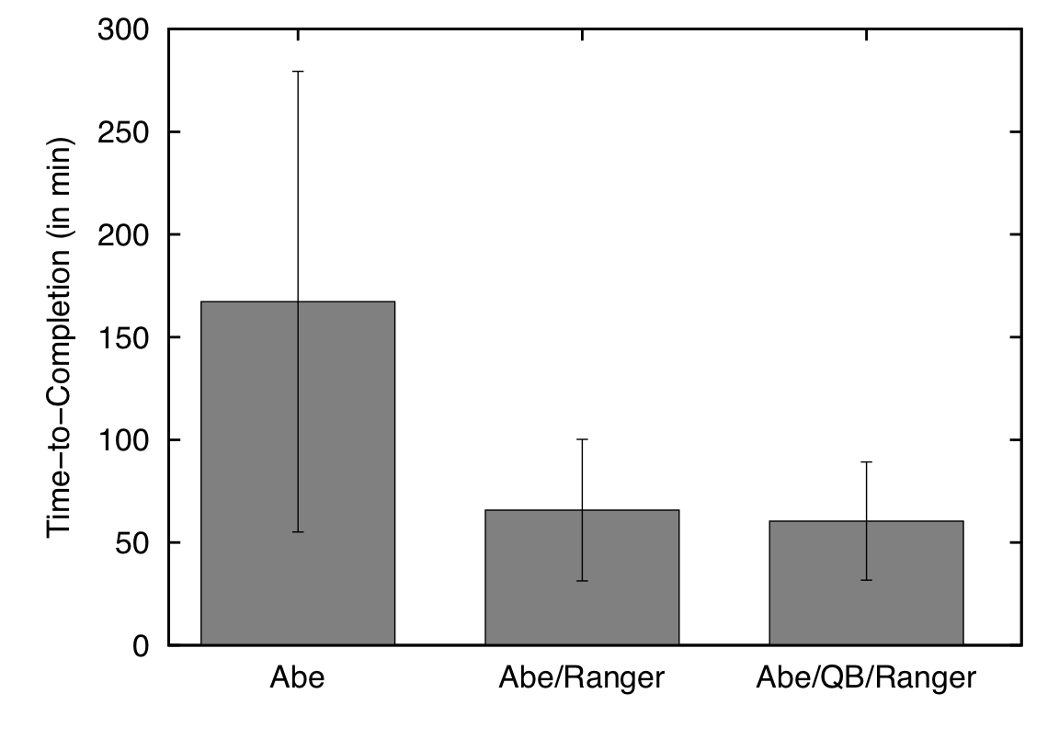
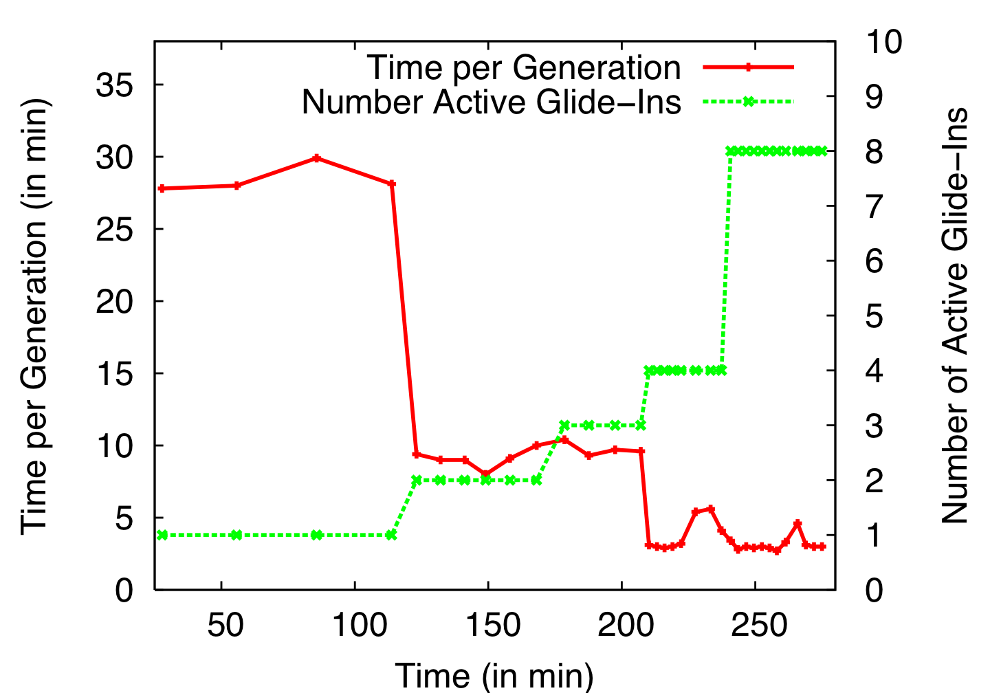
Distributed Adaptive Replica Exchange (DARE) Multiple Pilot-Jobs on the “Distributed” TeraGrid
Ability to dynamically add HPC resources. On TG:
Each Pilot-Job 64px
Each NAMD 16px
Time-to-completion improves
No loss of efficiency
Luckow, Kim, Schnor, Jha
Adaptive Replica-Exchange,
Phil. Trans of Royal Society A,
28 June 2009 vol. 367 no. 1897 2595-2606

Slide 28
Understanding Replica-Exchange
Why Distributed?
Many un-coupled units (ensembles/replica)
More resources, the merrier!!
How Distributed?
Many implementations exist (eg folding@home)
SAGA-based “Pilot-Jobs” to use many distributed TG resources
Limitations and Success?
Getting SAGA working on all machines!
Finding the best set of resources
Coordinating work across all the resources

Slide 29
CLIMATEPREDICTION.NET

Slide 30
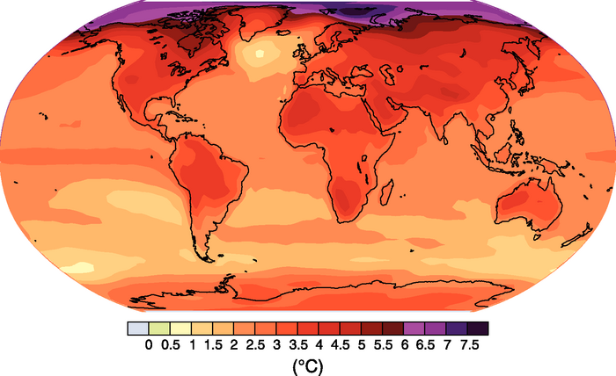
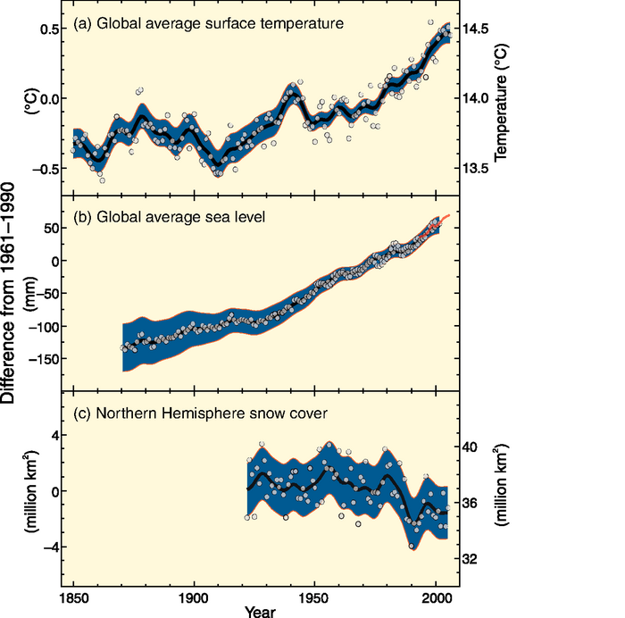
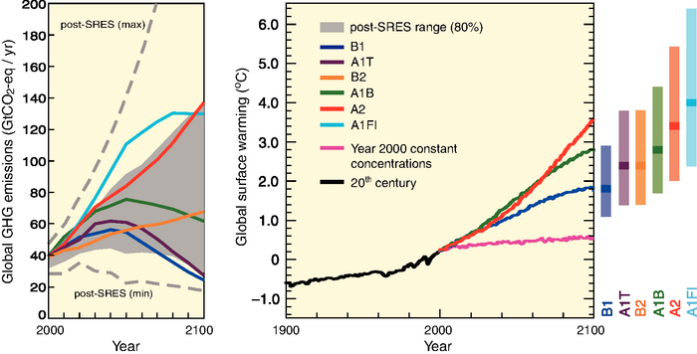
IPCC AR4: http://www.ipcc.ch/publications_and_data/ar4/syr/en/contents.html

Slide 31
Understanding ClimatePrediction.net
Why Distributed?
Many small indep. Comp. tasks – naturally decomposable
Access many more resources without owning
Petaflop computing years before Petaflop Computing era!?
How Distributed?
BOINC -- basis for @HOME projects [Volunteer Computing]
“Trickles” – job reporting to the Master (project server)
Data too large to aggregate and analyze centrally
Hence must operate on data in-situ
Limitations and Success?
Coordinating work across all the resources
Managing changing number of resources and failures

Slide 32
SCOOP..

Slide 33
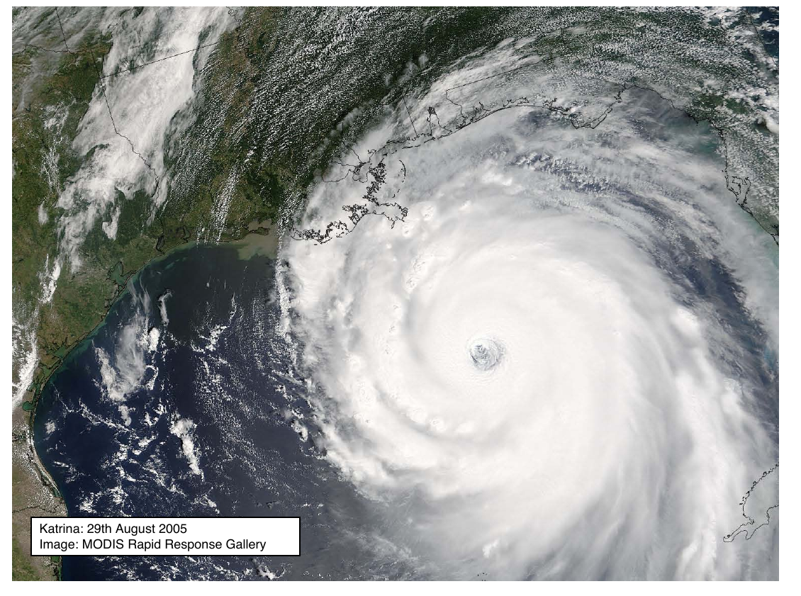

Slide 34
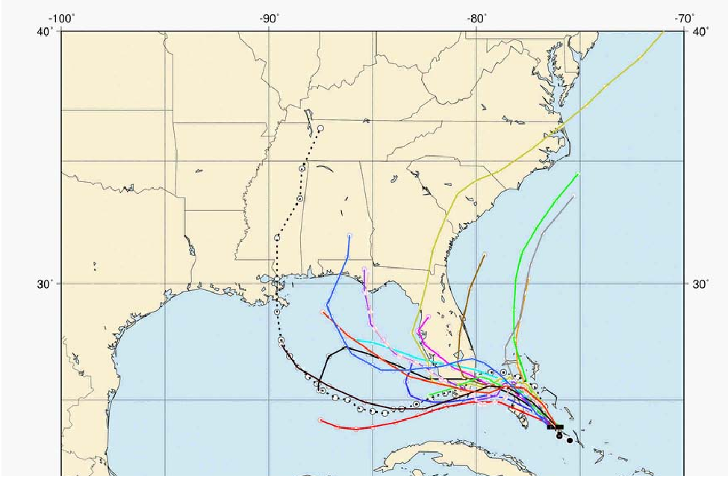
Need To Simulate Faster than Real Time!

Slide 35
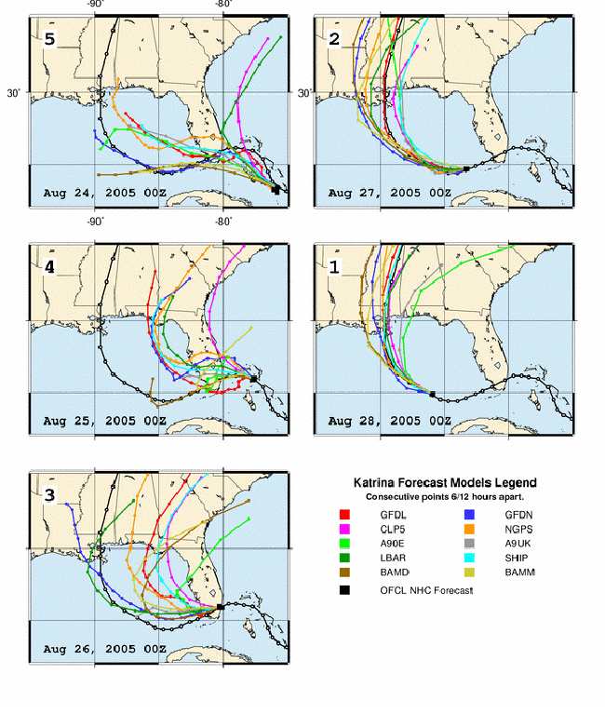
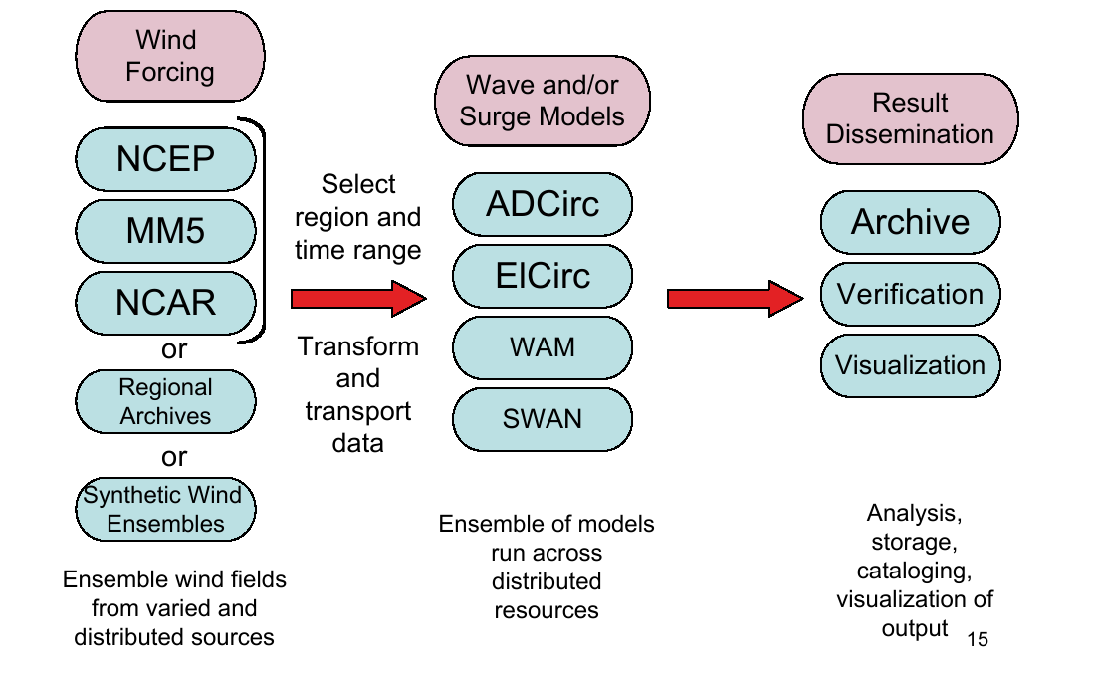
Heterogenous: Compute Models

Slide 36
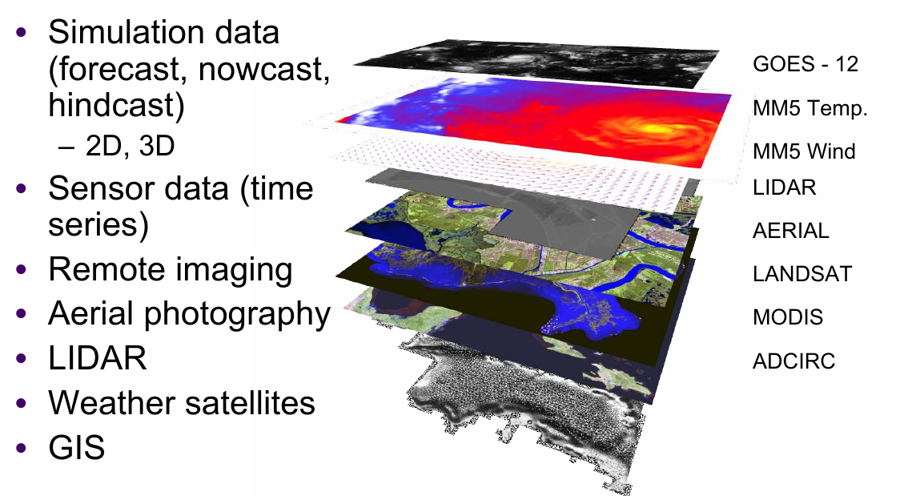
Many Heterogeneous Components

Slide 37
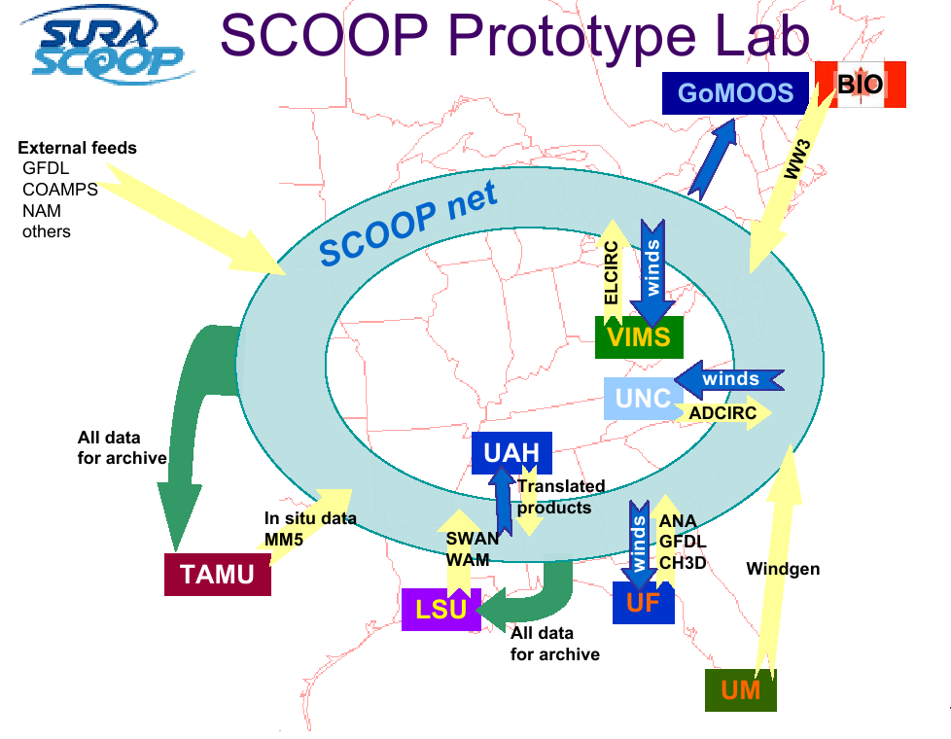
Naturally Distributed..

Slide 38
Understanding SCOOP
Why Distributed?
Naturally Distributed: Geographically distributed producers and end-users
High Peak Demand and quick response time
But with very low duty cycle --- Economic Argument !!
How Distributed?
Customized workflows
Limitations and Success?
Not Robust – Many components that need to come together
Coordinating work across all the resources
Co-scheduling / Advanced Scheduling / Prediciton a challenge

Slide 39
Distributed Applications How do they differ from traditional HPC applications?
Performance Models:
Not just “peak utilization”; e.g., HPC & HTC (# of jobs)
Skillful Decomposition vs Aggregation
Primacy of Coordination across distributed resources
Usage Modes:
The same application has multiple usage modes
How applications are developed, deployed and executed is often determined by the infrastructure
Execution Environment
Typically not as well controlled or defined
Varying resource conditions, application requirements
HW Assignment: Think about applications we’ve studied and see if the above is true?

Slide 40
Overview of Module E Distributed Scientific Computing
E1: Introduction to Distributed Scientific Computing
Examples of Distributed Applications : [30 minutes]
WLCG + Application Examples
Summarize and compare with HPC
Examples of “Production” Grid Infrastructure [30 min]
HPC vs HTC, Research vs Production, Commercial
Distributed Computing is Hard. Why? [15]
E2: Introduction to the Practice of DSC [45 mins]
Introduction to SAGA and installing it
Writing your first distributed application
Mod E Project [10mins]

Slide 41
Production Distributed Infrastruc
HPC Grids
XSEDE/TeraGrid [DEISA]
HTC Grids
OSG, EGI
Research Grid Infrastructure
FutureGrid, [Grid5000, DAS]
Commercial Infrastructure
AWS (EC2, S3), Azure

Slide 42
Why are we examining DI?
Sapir-Whorf Hypothesis:
Language Influences the Habitual Thought
Scientific Computing Analog:
Infrastructure shapes the practice and formulation of research
Think historically how CI has shaped research
“I have a research Q. Which CI should I use?”
Go to TG? Go to OSG? Or should I pay for resource?
Might the policies of these DI influence your decision?
This lecture (part) aims to provide a quick overview and understanding of the infrastructures available
For each, (i) Description, (ii) Management, (iii) Typical Usage Modes and applications supported, (iv) Policies

Slide 43
TeraGrid US National Cyberinfrasctructure for Scientific Research

Slide 44
11 Resource Providers
Grid Infrastructure Group (UChicago)
UW
UC/ANL
PSC
NCAR
PU
NCSA
Caltech
IU
UNC/RENCI
ORNL
USC/ISI
NICS
SDSC
LONI
TACC
Resource Provider (RP)
Software Integration Partner

Slide 45
TeraGrid Resources and Services
Computing
- More than one petaflop of computing power today and
growing
500 Tflop Ranger system at Texas Advanced Computing Center (TACC)
466 TFlop Kraken (Cray Xt4) at National Institute for Computational Sciences (NICS), University of Tennessee
Remote visualization servers and software
60 TFlop condor-based viz resource at Purdue University
Data
Allocation of data storage facilities
Over 100 Scientific Data Collections
Central allocations process
Technical Support
Central point of contact for support of all systems
Advanced Support for TeraGrid Applications (ASTA)
Education and training events and resources
Over 30 Science Gateways

Slide 46
TeraGrid Usage Modes in CY2008
Use of TeraGrid Resources | # of projects
Batch Computing on Individual Resources | 850
Exploratory and Application Porting | 650
Workflow, Ensemble, and Parameter Sweep | 160
Science Gateway Access | 100
Remote Interactive Steering and Visualization | 35
Tightly-Coupled Distributed Computation | 10
Notes:
Needs updating to 2008. This might be revised to focus on the wide range of types of TG uses. I removed pie charts because they confused the message for me. I also think that the numbers may be unnecessary – the kinds of use could just as easily be bulleted.

Slide 47
Policies and Operational Details
Management: GIG – central point of coordination
Top-down process of determining who the resource providers (RP) are
Eg LSU/LONI is an RP via a NSF HPCOPS award
User needs allocation to access resource
Eg TRAC, PRAC, Educational
Allocation typically bound to a resource
We talked about co-scheduling
Is not provided for all intents and purposes
Users typically use a single resource at a time
See Usage Mode table
Notes:
While addressing challenges in nanotechnology, NCN researchers produce new algorithms, approaches, and software with capabilities not yet available commercially. As part of the NSF's infrastructure for the National Nanotechnology Initiative (NNI), the NCN engages the community through workshops, seminars and novel educational resources. The nanoHUB is a source of on-line resources including a unique web-based computational user facility that puts research-grade software in the hands of users across the globe.
was created in 2000 and relies on middleware developed at Purdue called PUNCH (Purdue University Network Computing Hub). In the year 2003, the nanoHUB has served 1000 users and ran 86,000 jobs
The applications already available on the nanoHUB range from single cpu jobs to parallel jobs. Some are well suited to run on a Condor pool, whereas more compute intensive application will run on the TeraGrid.

Slide 48

TeraGrid Usage
Notes:
Update to include additional communities added since 2006.

Slide 49
Open Science Grid http://www.openscience.org
Bottom-Up Organization: OSG brings together computing and storage resources from campuses and research communities into a common, shared grid infrastructure over research networks via a common set of middleware
Philosophy: OSG offers participating research communities low-threshold access to more resources than they could afford individually, via a combination of dedicated, scheduled and opportunistic alternatives
Management: OSG is a consortium of software, service and resource providers and researchers, who together build and operate the OSG project

Slide 50
Open Science Grid http://www.openscience.org
OSG Consortium members' independently owned and managed resources make up the distributed facility, agreements between them provide the glue for it
Organized around Virtual Organizations
Software: Virtual Data Toolkit provides packaged, tested and supported collections of software for installation on participating compute and storage nodes and a client package for end-user researchers.

Slide 51
OSG Middleware
User Science Codes and Interfaces
VO Middleware
Applications
Biology
Portals, databases etc
HEP
Data and workflow management etc
Astrophysics
Data replication etc
OSG Release Cache:
OSG specific configurations, utilities etc.
Virtual Data Toolkit (VDT) core technologies + software needed by stakeholders:many components shared with EGEE
Infrastructure
Core grid technology distributions:
Condor, Globus, Myproxy: shared with TeraGrid and others
Existing Operating, Batch systems and Utilities.

Slide 52
It takes VOs to make OSG work!
cdf Collider Detector at Fermilab
cms Compact Muon Solenoid
compbiogrid CompBioGrid
des Dark Energy Survey
dosar Distributed Organization for Scientific and Academic Research
dzero D0 Experiment at Fermilab
engage Engagement
fermilab Fermi National Accelerator Center
fmri Functional Magnetic Resonance Imaging
gadu Genome Analysis and Database Update
glow Grid Laboratory of Wisconsin
gpn Great Plains Network
grase Group Researching Advances in Software Engineering
gridex Grid Exerciser (GEx)
grow Grid Research and Education Group at Iowa
gugrid Georgetown University Grid
i2u2 Interactions in Understanding the Universe Initiative
ligo Laser Interferometer Gravitational-Wave Observatory
mariachi Mixed Apparatus for Radar Investigation . . .
nanohub nanoHUB Network for Computational Nanotechnology (NCN)
nwicg Northwest Indiana Computational Grid
osg Open Science Grid
osgedu OSG Education Activity
sbgrid Structural Biology Grid
sdss Sloan Digital Sky Survey
star Solenoidal Tracker at RHIC
usatlas United States ATLAS Collaboration

Slide 53
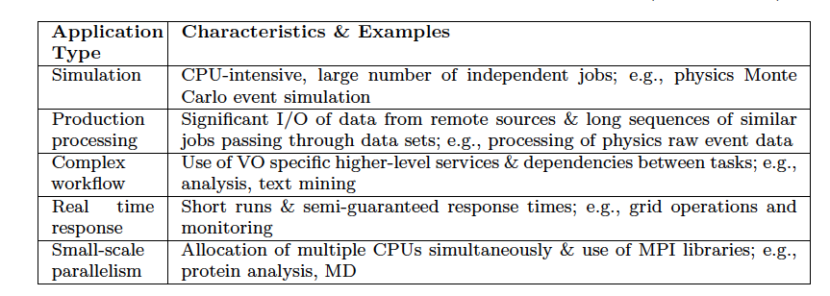
OSG Usage Modes

Slide 54

European Grid Initiative http://www.egi.eu/
The objective of EGI.eu (a foundation established under Dutch law) is to create and maintain a pan-European Grid Infrastructure in collaboration with National Grid Initiatives (NGIs) in order to guarantee the long-term availability of a generic e-infrastructure for all European research communities and their international collaborators
Coordinating activities between European NGIs EGI.eu will
Operate a secure integrated production grid infrastructure that federates resources from providers around Europe
Work with software providers within Europe and worldwide to provide high-quality innovative software solutions that deliver the capability required by our user communities

Slide 55
European Grid Initiative http://www.egi.eu/
Management Model: EGI Council with representatives from all National Grid Projects
EGI: Follow-on project to EGEE, EGEE-II and EGEE-III
Usage Modes:
Mostly HTC but not confined to HTC
All of OSG Usage Modes and more
Many diverse research areas and not just particle-physics

Slide 56
FutureGrid Goals
Support the research on the future of distributed, grid, and cloud computing.
Build a robustly managed simulation environment or testbed to support the development and early use in science of new technologies at all levels of the software stack: from networking to middleware to scientific applications.
Mimic TeraGrid and/or general parallel and distributed systems – FutureGrid is part of TeraGrid and one of two experimental TeraGrid systems (the other is based on GPU)
Enable major advances in science and engineering through collaborative development of science applications and related software using FG
FutureGrid is a (small 5600 core) Science Cloud but it is more accurately a virtual machine based simulation environment

Slide 57
FutureGrid Hardware
FutureGrid has dedicated network (except to TACC) and a network fault and delay generator
Can isolate experiments on request; IU runs Network for NLR/Internet2
(Many) additional partner machines will run FutureGrid software and be supported (but allocated in specialized ways)

Slide 58
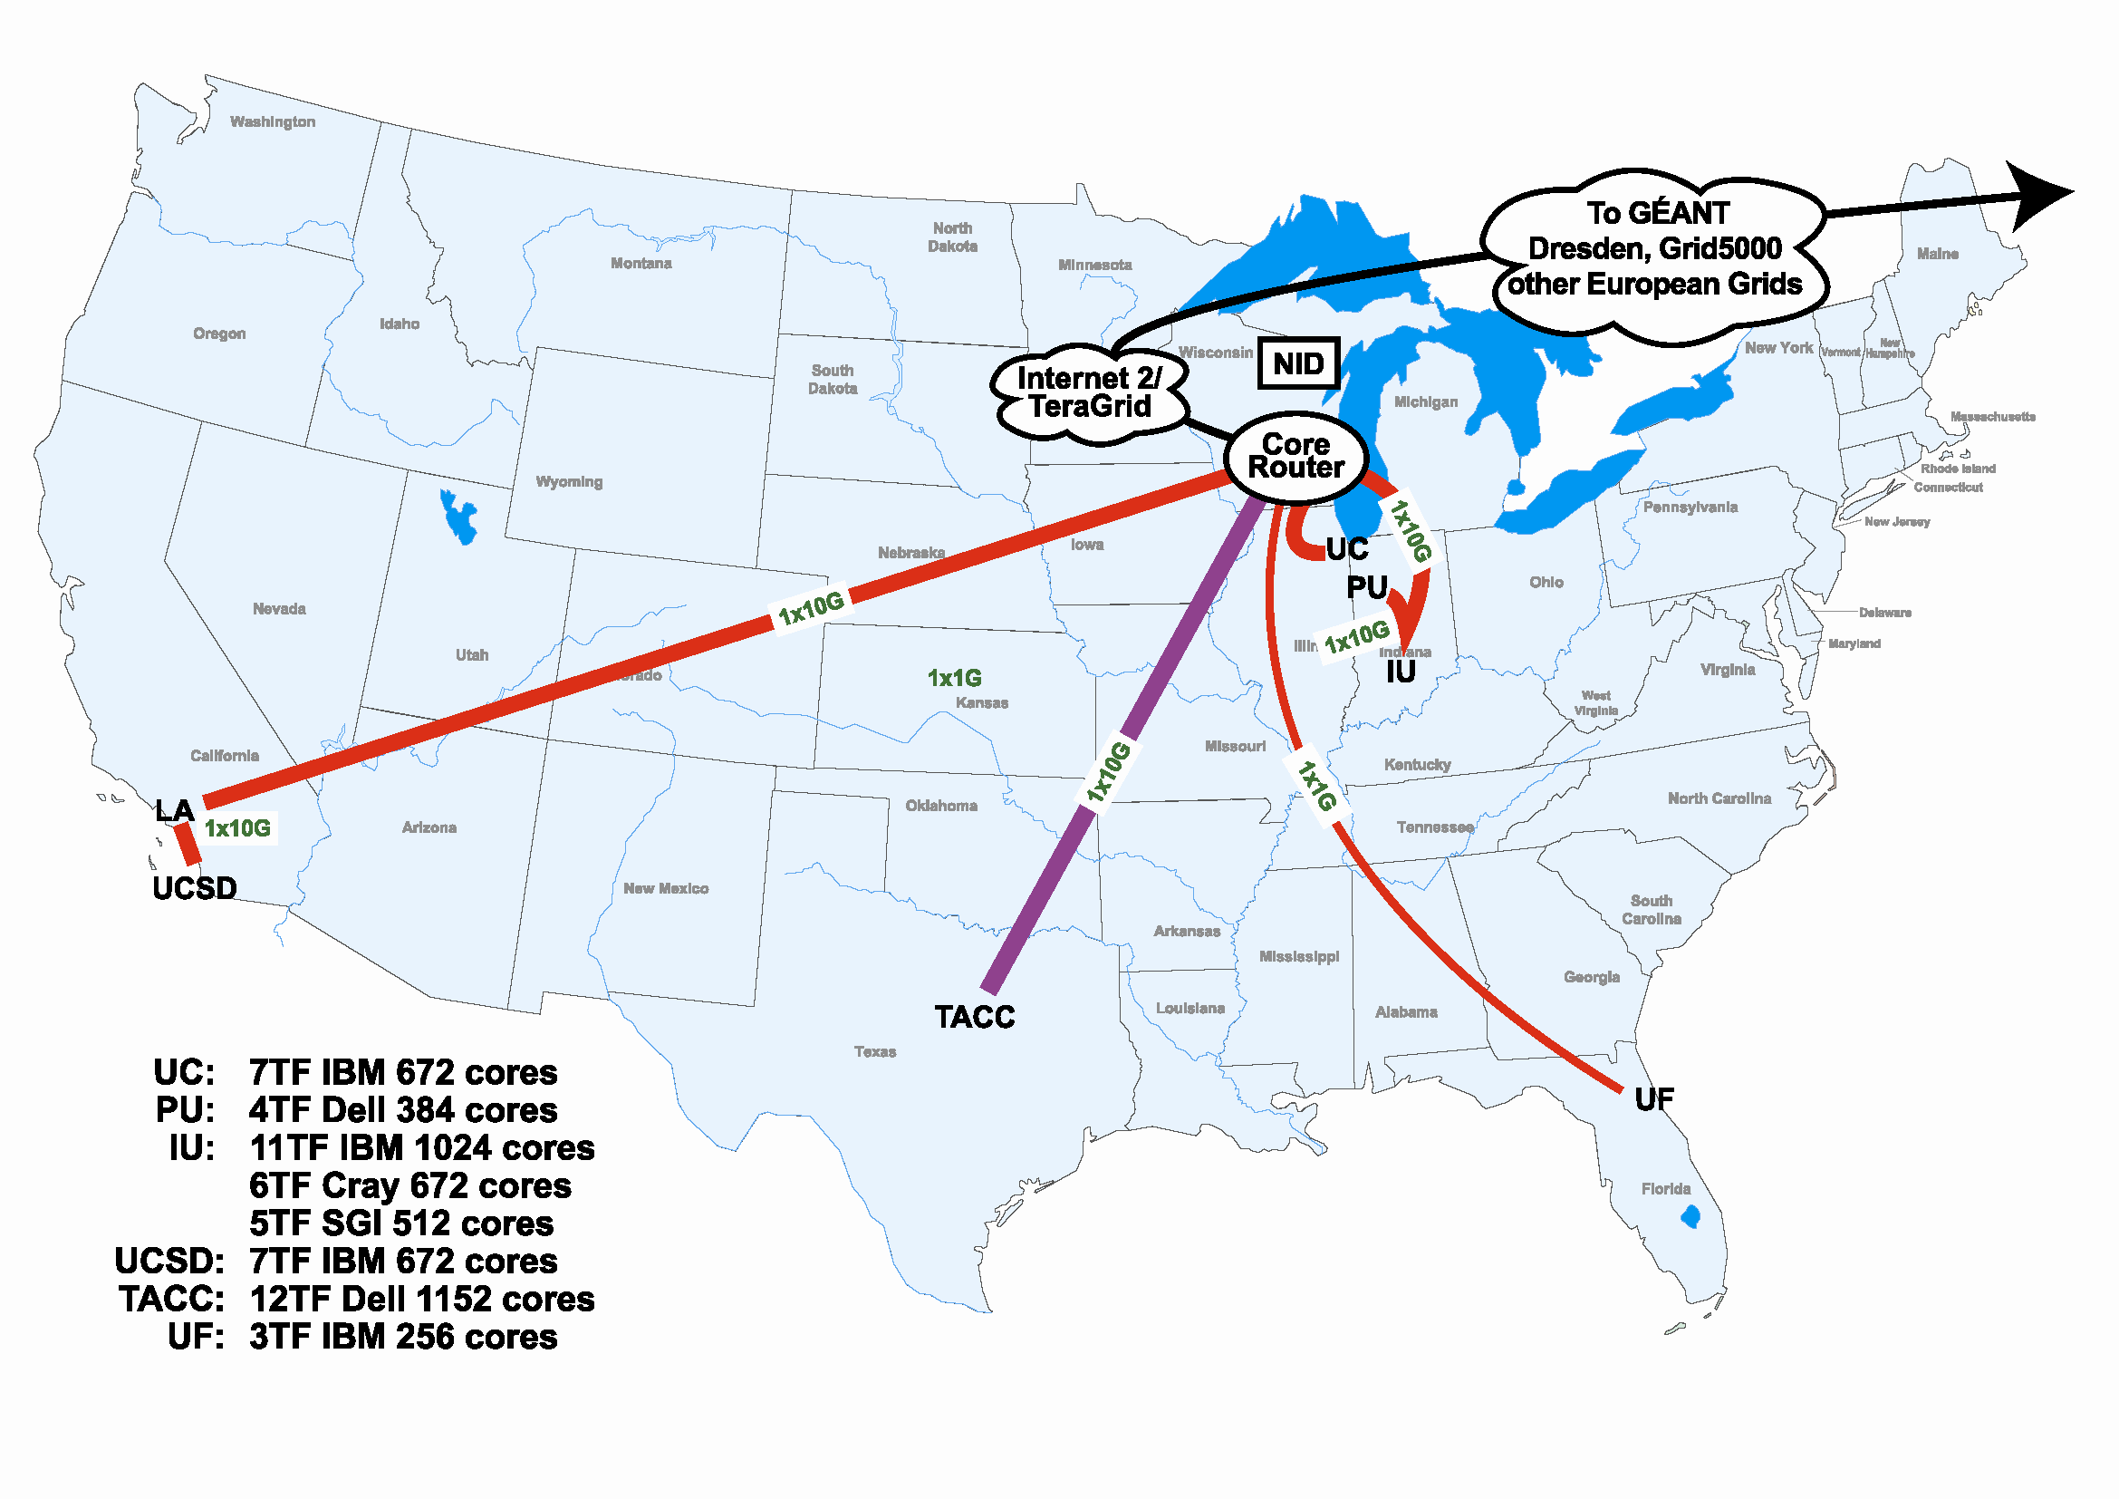
Add Network Fault Generator and other systems running FutureGrid Hardware

Slide 59
FutureGrid Usage Scenarios
Developers of end-user applications who want to develop new applications in cloud or grid environments, including analogs of commercial cloud environments such as Amazon or Google.
Is a Science Cloud for me?
Developers of end-user applications who want to experiment with multiple hardware environments.
Grid/Cloud middleware developers who want to evaluate new versions of middleware or new systems.
Networking researchers who want to test and compare different networking solutions in support of grid and cloud applications and middleware. (Some types of networking research will likely best be done via through the GENI program.)
Education as well as research
Interest in performance requires close to OS support

Slide 60
FutureGrid Architecture
Open Architecture allows to configure resources based on images
Managed images allows to create similar experiment environments
Experiment management allows reproducible activities
Through our modular design we allow different clouds and images to be “rained” upon hardware.
Note will be supported 24x7 at “TeraGrid Production Quality”
Will support deployment of “important” middleware including TeraGrid stack, Condor, BOINC, gLite, Unicore, Genesis II

Slide 61
Amazon AWS http://aws.amazon.com
Story goes: Build capacity for X-mas. What do with spare capacity year around?
“Utility Computing”
Around long before Amazon EC2
$0.10 per CPU-hour, plus bandwidth cost
*aaS Model:
* = Infrastructure, Software, almost anything
AWS: A set of APIs which give users access to Amazon technology and content
IaaS, but also “people as a service” – Mechanical Turk

Slide 62
Amazon Simple Storage Service (S3)
Data Storage in Amazon Data Center
Web Service interface
No set-up fee, No monthly minimum
Storage: $0.15 per GB/Month
Data Transfer: $0.20/GB to transfer data
Private and public storage
Each object up to 5GB in size

Slide 63
Amazon Elastic Compute Cloud
A Web service that provides resizable compute capacity in the cloud. Designed to make Web-scale computing easier
A simple Web service interface that provides complete control of your computing resources
Quickly scales capacity, both up and down, as your computing requirements change
Changes the economics of computing:
Pay only for capacity that used; no cost of ownership
a + bc becomes just bc

Slide 64
Amazon Elastic Compute Cloud
No start-up, monthly, or fixed costs
$0.10 per CPU hour
$0.20 per GB transferred across Net
No cost to transfer data between Amazon S3 and Amazon EC2
More when we do Cloud Computing next week

Slide 65
Azure
Description: Microsoft’s “Platform as a Service” (Paas) offering
Platform that is “Available” and “Scalable”
Cloud Based around virtualization
Explicit Cost to Use
No cost to transfer data, only to use/store
“Democratization of Infrastructure”
Rich Data Abstractions
Large user data items: blobs
Service state: tables
Service workflow: queues
Simple and Familiar Programming Interfaces
REST: HTTP and HTTPS

Slide 66
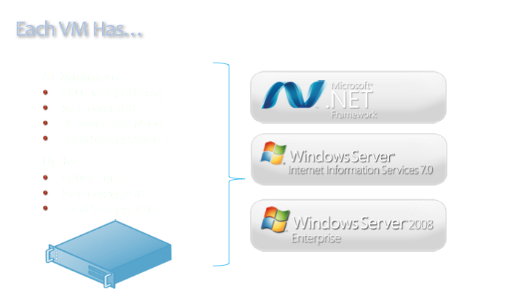

Slide 67
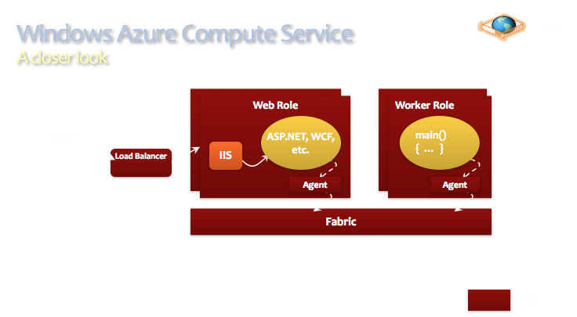

Slide 68
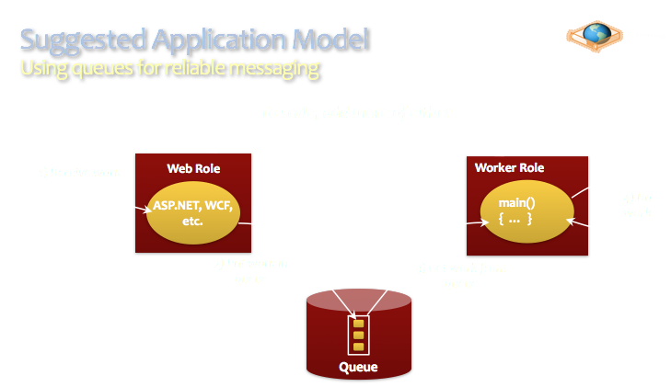

Slide 69
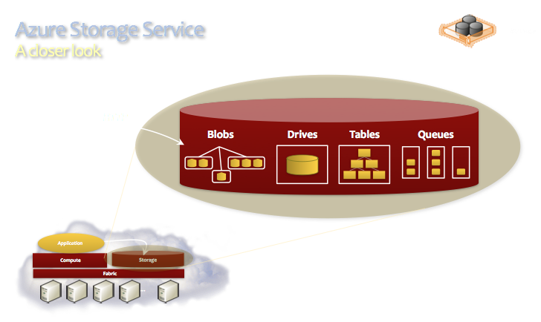

Slide 70
DI - Summary
A rich space of infrastructure & capabilities
Not all DI have delivered on “their Grid” role
Why is difficult to answer, as many co-dependent factors, e.g. policy, social/technical/software ecosystem, external pressures..
But in general, “Narrow grid” (e.g OSG) have done better versus “Broad grids” (eg Teragrid)
Interesting developments in the commercial sector: Google, Microsoft and Amazon
First time ever, Academic Research being done on commerical infrastructure!
Due to rise of data-intensive computing but also well designed infrastructure (Azure) and effective abstractions for applications (MapReduce)

Slide 71
Overview of Module E Distributed Scientific Computing
E1: Introduction to Distributed Scientific Computing
Examples of Distributed Applications : [30 minutes]
WLCG + Application Examples
Summarize and compare with HPC
Examples of “Production” Grid Infrastructure [30 min]
HPC vs HTC, Research vs Production, Commercial
Distributed Computing is Hard. Why?
E2: Introduction to the Practice of DSC [45 mins]
Introduction to SAGA and installing it
Writing your first distributed application
Mod E Project [10mins]

Slide 72
Introduction to SAGA and SAGA-BigJob Piloting Many Simulations on Many Supercomputers
RADICAL TEAM
http://radical.rutgers.edu

Slide 73
“Many Simulations” Scenarios: Context
A Single “Application” is broken into many smaller tasks
Naturally decomposed or “by design” (algorithmic and infrastructural)
Varying task duration: hours to days to weeks
Often these tasks are “coupled”:
General concept for data sharing, synchronization, other dependency
Decouple workload and resource management
Coupling between these tasks
Uncoupled Tasks, Loosely-Coupled Tasks, Sequential dependencies..
Homogenous or Heterogeneous
Varying rate of coupling between tasks
Regular versus Irregular synchronization:
Temporal, Spatial
Ad hoc (pair-wise) exchange
No a priori determined exchange partners

Slide 74
Scalable approaches to many simulations on many machines
Introducing the Pilot Abstraction
SAGA-BigJob: A simple, extensible and interoperable PJS
SAGA: The Interoperability Layer
BigJob: Case Studies of varying the coupling between tasks
Notes:
How we have used open source, standard-based API to construct powerful tools.
Dynamic Resource Management: A plus (+)

Slide 75
PART-I: Introducing Pilot-Abstractions

Slide 76
Introduction to Pilot-Abstraction
Working definition: a system that generalizes a placeholder job to provide multi-level scheduling to allow application-level control over the system scheduler via a scheduling overlay
User Space
User Application
Pilot-Job System
Policies
Pilot-Job
Pilot-Job
Resource Manager
System Space
Resource A
Resource B
Resource C
Resource D
Notes:
Get slides of Pilot Jobs from Ole
Pilot-jobs as a (A)RM because of limitations of the middleware and infrastructure. Different middleware; differenent limitations. Therefore different pilot jobs semantically and functionally.

Slide 77
Introduction to Pilot-Abstraction (2)
Working definitions:
A system that generalizes a placeholder job to provide multi-level scheduling to allow application-level control over the system scheduler via a scheduling overlay
“.. defined as an abstraction that generalizes the reoccurring concept of utilizing a placeholder job as a container for a set of compute tasks; an instance of that placeholder job is referred to as Pilot-Job or pilot.”
Advantages of Pilot-Abstractions:
The Perfect Pilot: Decouples workload from resource management
Flexible Resource Management
Enables the fine-grained (ie “slicing and dicing”) of resources
Tighter temporal control and other advantages of application-level Scheduling (avoid limitations of system-level only scheduling)
Move control, extensibility and flexibility “upwards”
Build higher-level capabilities without explicit resource management
Notes:
Pilot-jobs as a (A)RM because of limitations of the middleware and infrastructure. Different middleware; differenent limitations. Therefore different pilot jobs semantically and functionally.
Pilots tell you what to do (N x M) but not why or how?

Slide 78
Pilot-Jobs Systems (PJS): Five Myths
PJS do not need well defined architecture, model and semantics, or, PJs are such a simple concept, they don't need more “attention”
Not to confuse “simple to use” with simple to design”
PJS are only about meta-scheduling (reducing queuing delays) on HTC, or, PJS unfairly game HPC queuing
There are interesting usage modes beyond “cycle stealing”
PJS have to be tied to specific DCI; DCI are tied to specific PJ
Extensibility and interoperability have been difficult to establish
PJS are passive (system) tools, as opposed to user-space, active and extensible components of a CI
PJs can be user-controlled “programmable” elements
PJS do not help with next-generation “data-intensive” applications
PJ for NGS O(10-100) GB per task on existing DCI
Notes:
1a Everyone should write their own PJ just because they can!
1b Not to confuse “simple to use” but not necessarily simple to implement for scale
Separate deployment issues from runtime (execution) models

Slide 79
Pilot-Job Paradigm
Based upon analysis of several Pilot-Job implementations
Architecture: Three distinct logical elements:
Workload Manager: Responsible for making available the tasks to the executor alongside the needed data and retrieving results
Task Executor: Responsible for executing the tasks while managing their data.
Communication and Coordination (C-C): Patterns allow for and regulate the interaction between (and within) these two components.
Execution Patterns: Based on multi-level scheduling and late-binding
Multi-level scheduling. Tasks of a workload are scheduled on one or more pilots and the pilots are then scheduled on a given resource
Capability/Functionality: A system that generalizes a placeholder job to provide multi-level scheduling to allow application-level control over the system scheduler via a scheduling overlay

Slide 80
BigJob: A simple, extensible and interoperable Pilot-Job System

Slide 81
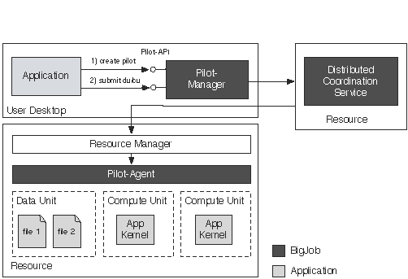
BigJob: Architecture

Slide 82
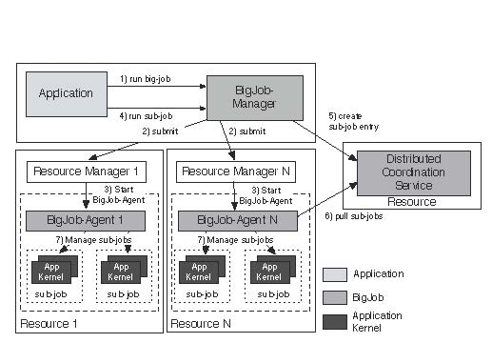
BigJob: Distributed View (Strongly encourage you to try after the tutorial)

Slide 83
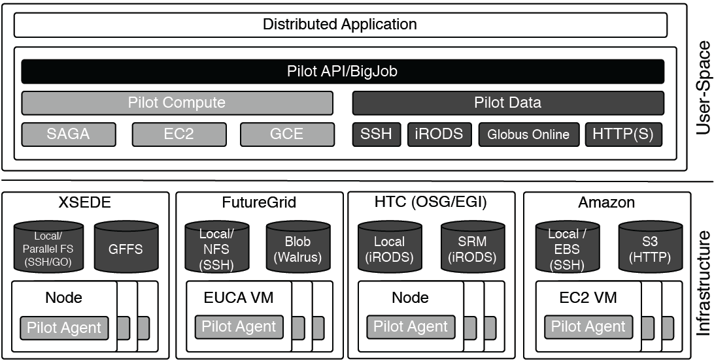
BigJob: Resource Interoperability

Slide 84
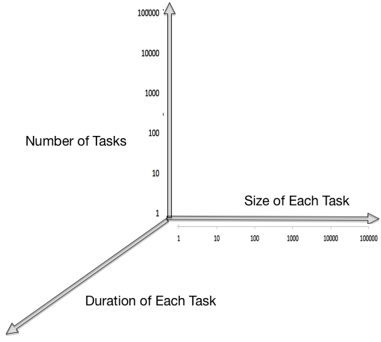
Design Objective: Scaling Along Many Dimensions
Scaling Dimension #1: Size of each task
Scale-up
1 core per task,128/512…..
Scaling Dimension #2: Total Number of Concurrent tasks
Scale-Out
Enhanced (MD) sampling O(1000), statistical errors O(10^6) tasks,
Scaling Dimension #3: Total Number of Tasks/per unit time
Real time processing O(1000)
Scaling Dimension #4: Number of Resources Used
Scale-Across
Execute on Grids, Clouds, Clusters

Slide 85
“Coarse-Grained” BigJob Performance
Number of zero-payload tasks that BJ can dispatch per second:
Distributed: O(10)
Locally: > O(10)
Number of Pilots (Pilot-Agents) that can be marshaled
Locally/Distributed: O(100)
Typical number of tasks per Pilot-Agent:
Locally/distributed: O(1000)
Number of tasks concurrently managed = Number of Pilot-Agents x tasks per each agent :
O(100) x O(1000)
(Obviously) The above depends upon data per task:
BigJob has been used over O(1)--O(10⁹) bytes/task, for tasks of duration O(1) second to O(10⁵) seconds

Slide 86
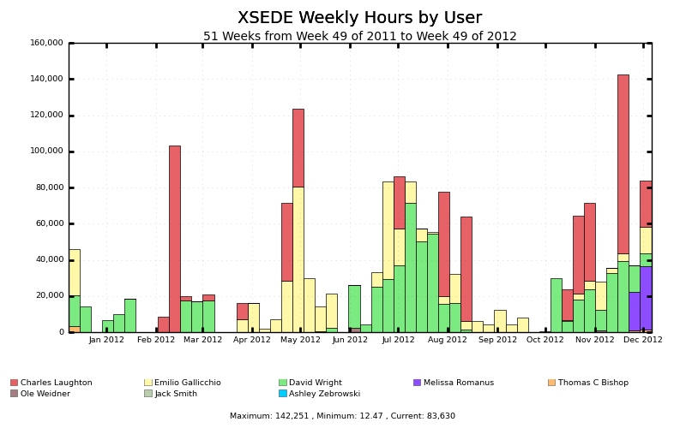
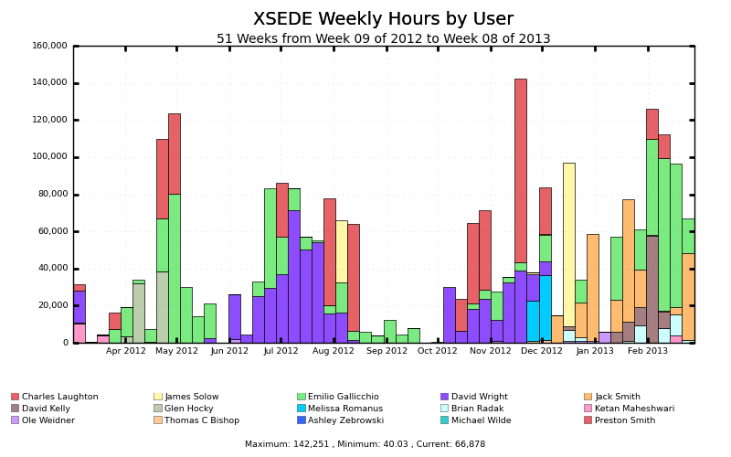
BigJob: (Partial) Usage on XSEDE Machines
> 10M SUs/year (and increasing) on XSEDE machines

Slide 87
SAGA: Interoperability Layer for BigJob
http://saga-project.org
http://saga-project.github.io/saga-python
A Light-Weight Python Access Layer for Distributed Computing Infrastructure

Slide 88
Overview
SAGA: Simple API for Distributed (“Grid”) Applications
Application level standardized (Open Grid Forum GFD.90) API
Application is a broad term: “one person’s application is another person’s tool (building block)”.
SAGA-Python:
Native Python implementation of Open Grid Forum GFD.90
Allows access to different middleware / services through a unified interface
Provides access via different backend plug-ins (“adaptors”)
SAGA-Python provides both a common API, but also unified semantics across heterogeneous middleware:
Transparent Remote operations (SSH / GSISSH tunneling)
Asynchronous operations
Callbacks
Error Handling

Slide 89
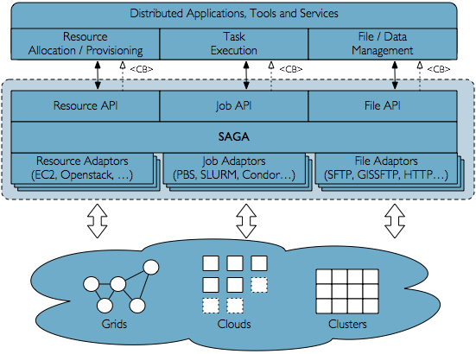
Schematic

Slide 90
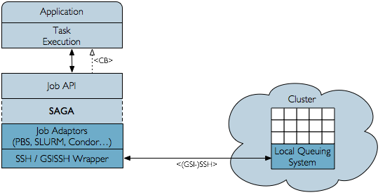
Transparent Remote Operations
Fast and optimized (GSI-)SSH command transport wrapper can be used by adaptors to access otherwise ‘local-only’ services, like many queuing systems

Slide 91
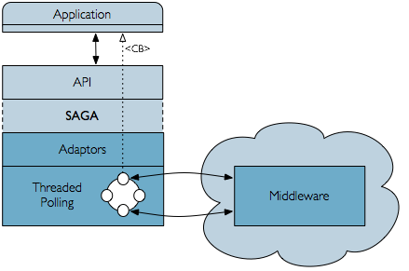
Transparent CALLBACKS
Callbacks and asynchronous operations are important concepts in distributed applications but are not supported by all middleware systems
SAGA-Python moves application-level polling into the adaptor layer and exposes a clean callback interface through the API

Slide 92
Available adaptors
http://saga-project.github.io/saga-python/doc/adaptorssaga.adaptor.index.html
Job Submission Systems
SSH, GSISSH, Condor, Condor-G, PBS(-Pro), TORQUE, SGE, SLURM.
Under development: LSF
File / Data Management
SFTP, GSIFTP, HTTP, HTTPS.
Under development: iRODS (Globus Online)
Resource Management / Clouds
Amazon EC2, Openstack (‘libcloud’-based)
http://saga-project.github.io/saga-python/doc/adaptors/saga.adaptor.ec2_resource.html

Slide 93
SAGA: Interoperability layer upon which other tools and applications are built
HOW SAGA is Used?
Uniform Access-layer to DCI, e.g, EGI, XSEDE, etc
Application “Scripting Layer” to DCI
Build tools, middleware services and capabilities e.g. Gateways,
WHAT is SAGA Used for?
Production-grade science and engineering and research tool to design, implement and reason about distributed programming models, systems and applications
Where is SAGA Used?
Pilot-job and Workflow systems, science gateways and web portals
Domain-specific (distributed) applications, libraries and frameworks

Slide 94
Case Studies: Varying the “coupling” between many (MD) Simulations

Slide 95
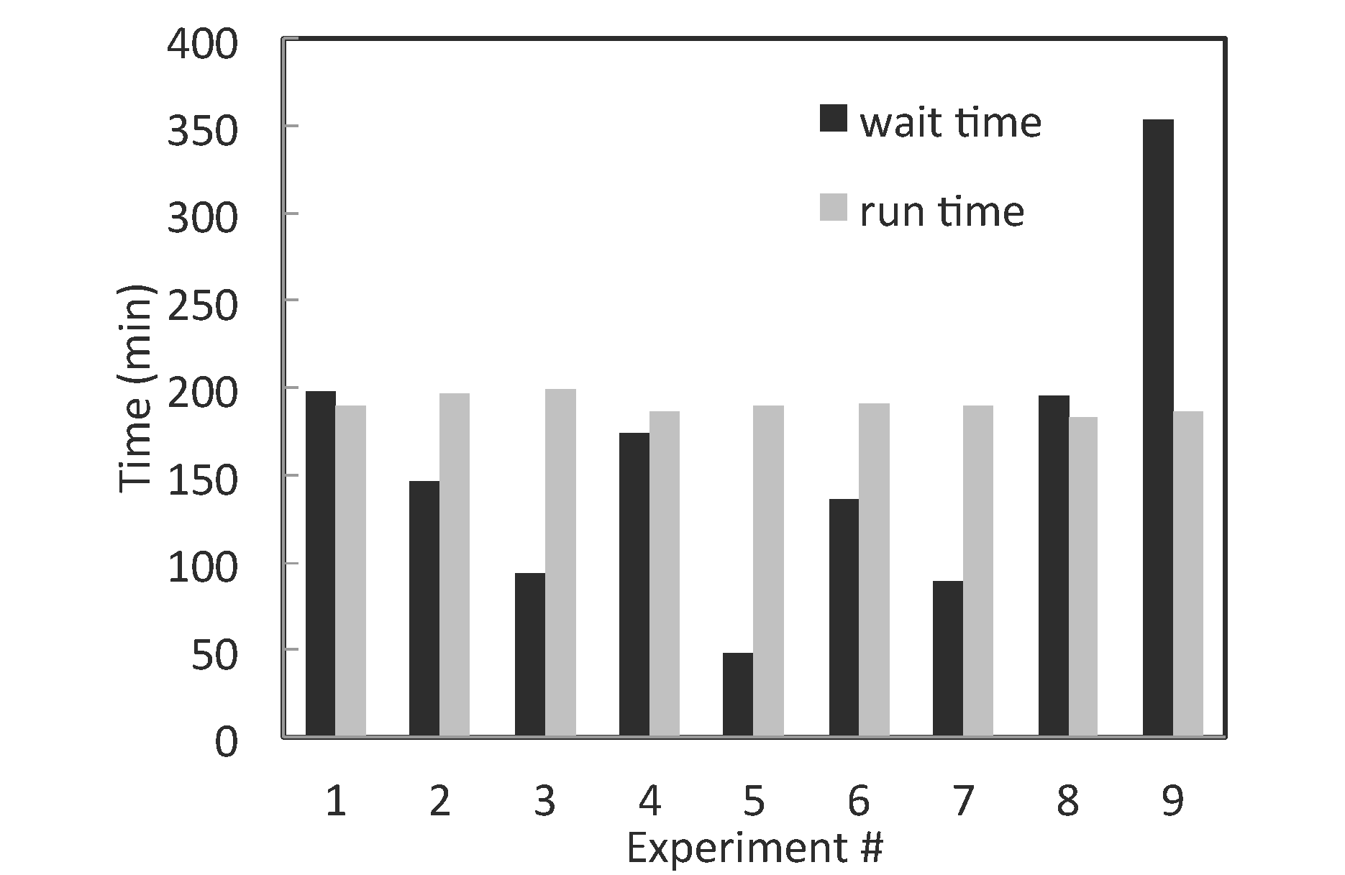
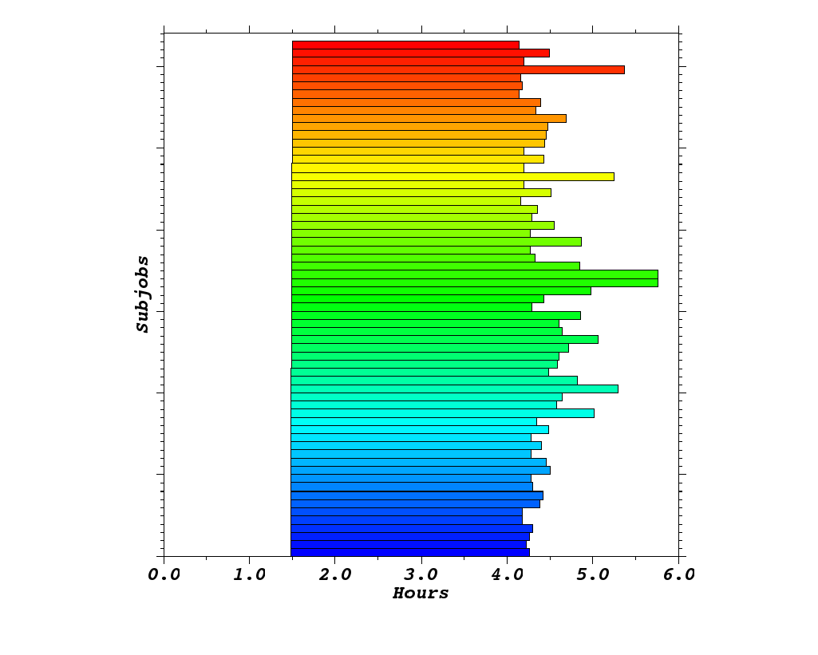



HT-HPC on Kraken 126 ensembles, each of 192 cores = 24192 cores

Slide 96


Scale-Out/Across
X-axis: number of tasks (size)

Slide 97

Scaling Along Many Dimensions

Slide 98
Varying the Coupling between Simulations
Large Ensemble of Uncoupled (Molecular) Simulations:
Enhanced Sampling of bio-molecular systems
Multiple-Chaining of Simulations
Long time-scale simulations
Ensemble of Loosely Coupled Simulations
Replica-Exchange Class of Algorithms
Understand protein-ligand recognition via (multidimensional) replica-exchange
Requirements:
Launch and monitor/manage (order 10²-10⁴) ensemble members
Where each ensemble member could be 128-1024 cores
Varying degrees of coupling between ensemble members
Varying job duration: hours to days to weeks
Ad hoc pair wise (a)synchronous data exchange

Slide 99








Replica Exchange Molecular Simulations
R₁
R₂
R₃
R_{N}
hot
T
t
300K
t
Exchange attempts

Slide 100
Irregular Synchronization

Slide 101
References
``P*: A Model of Pilot-Abstractions”, 8th IEEE International Conference on e-Science 2012 (DOI: 10.1109/eScience.2012.6404423)
“Distributed Computing Practice for Large-Scale Science & Engineering Applications” Computing and Concurrency: Practice and Experience, 2012 (DOI: 10.1002/cpe.2897)
“Pilot-Data: An Abstraction for Distributed Data”,
arXiv:1301.6228
“Pilot MapReduce”, 3rd Workshop on MapReduce and its applications (2012), in conjunction with HPDC (Delft)

Slide 102
References
SAGA-Python:
http://saga-project.github.io/saga-python/
BigJob: An implementation of P*
http://saga-project.github.io/BigJob/
RADICAL:
http://radical.rutgers.edu/
Publications:
http://radical.rutgers/edu/publications
Tutorials:
https://github.com/saga-project/tutorials/wiki/XSEDE13

Slide 103
Homework #1
Go to http://saga-project.org
Focus on SAGA-Python
http://saga-project.github.io/saga-python/
Find link to Tutorial:
http://saga-project.github.io/saga-python/doc/tutorial/
Do tutorial. Send me output of every subsection, describe the output (why?) of each sub-section.
Use Stamped, Trestles and/or Lonestar for remote tests
Use mailing list:
saga-users@googlegroups.com

Slide 104
Homework #2
BigJob Homepage:
http://saga-project.github.io/BigJob/
Find link to Tutorial
http://saga-project.github.io/BigJob/sphinxdoc/tutorial/index.html
Do tutorial. Do tutorial. Send me output of every subsection, describe the output (why?) of each sub-section.
Use Stampede, Trestles and/or Lonestar for remote tests
Use Mailing lists (bigjob-users@googlegroups.com)
If you have access to Stampede, URL for Tutorial: https://github.com/saga-project/tutorials/wiki/XSEDE13

Slide 105
Module E: Project Suggestions
Gain sufficient proficiency with SAGA to write a M-W application that uses > 1 FutureGrid resource?
Extend Mandelbrot Set? Use > 1 FutureGrid Resource?
PySAGA M-W? Implement another pattern?
See FG Tutorial on Nimbus and Eucalyptus
Can use SAGA to submit jobs to Clouds
M-W to submit to FG-Bare Metal & Clouds?
Written Project. Ideas?
Teamwork is acceptable provided: (i) effort is acknowledged, (ii) clear intellectual contribution from each

